Slide 1
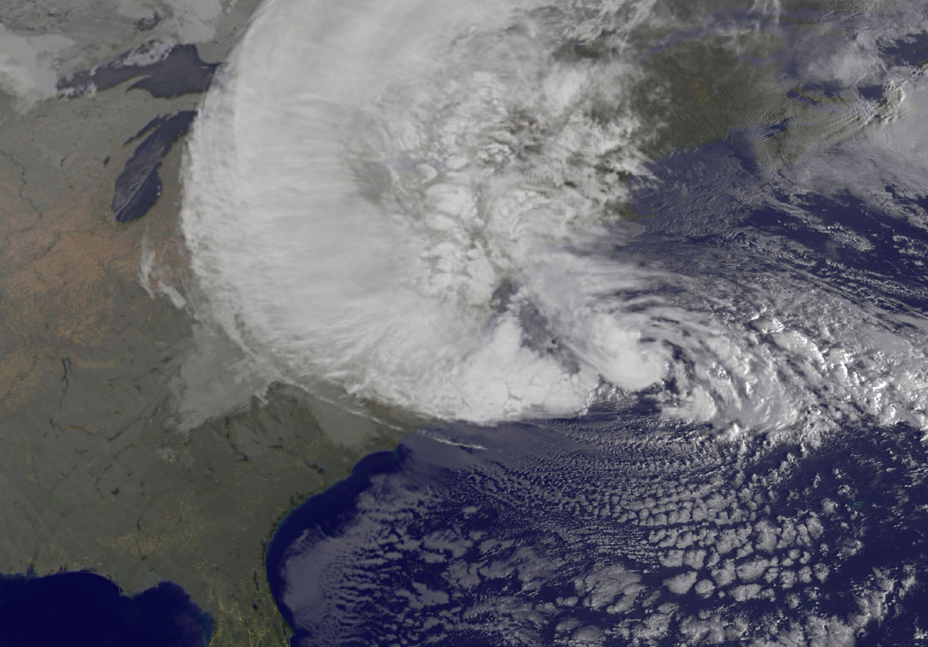
Framework for approaching climate change and health
US Climate and Health Alliance
Webinar, May 14, 2014
Jonathan Patz, Professor & Director

Slide 2
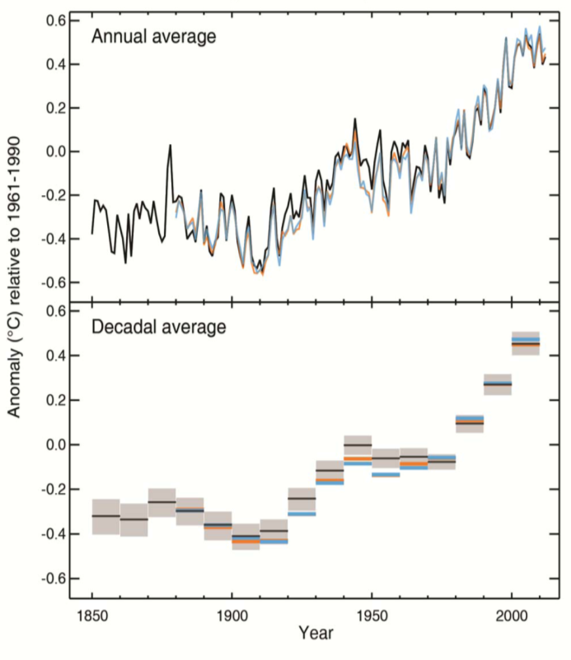
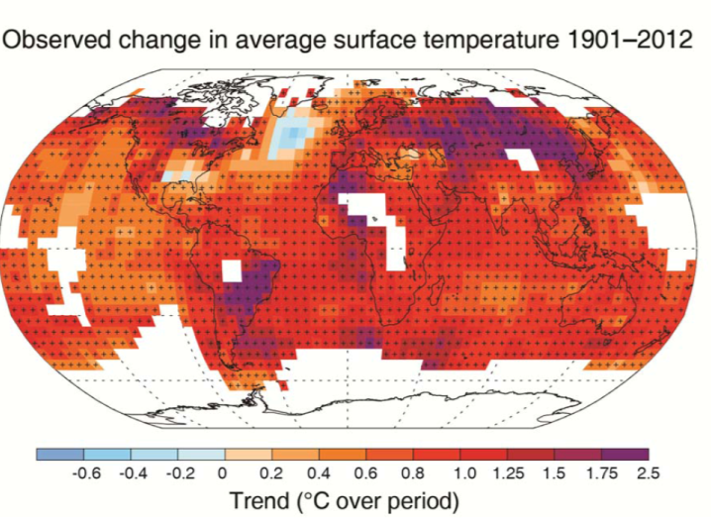
Temperature data
Global Temperature Anomaly 1850-2012
“The globally averaged combined land and ocean surface temperature data .. show a warming of 0.85 [0.65 to 1.06]°C, over the period 1880–2012” IPCC AR5 WG1 2013
IPCC AR5 WG1 Figure SPM.1
Notes:
The globally averaged combined land and ocean surface temperature data as calculated by a linear trend, show a warming of 0.85 [0.65 to 1.06] °C 3, over the period 1880–2012, when multiple independently produced datasets exist. The total increase between the average of the 1850–1900 period and the 2003–2012 period is 0.78 [0.72 to 0.85] °C, based on the single
longest dataset available4. (Figure SPM.1a) {2.4}

Slide 3
Warming clearly not related to 11-year solar “sun spot” cycle (in red)

Slide 4
Just one reason why ~97% of climate scientists (out of >4,000 surveyed) agree that today’s heating of the earth is human-caused, primarily from burning fossil fuels, and by deforestation. Doran & Zimmerman, 2009; Anderegg et al. 2010, PNAS.
Warming clearly not related to 11-year solar “sun spot” cycle (in red)

Slide 5
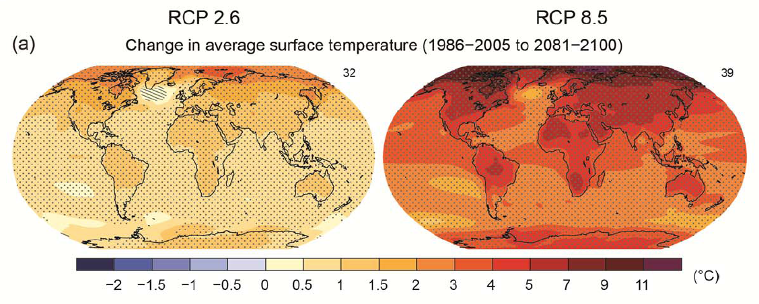
Global Climate Change
Regional Changes: Land areas warm more than ocean areas, so Africa warms more than the global average
IPCC, AR5, 2014
Notes:
1-5 degrees represents the range of warming for the RCP4.5 pathway. The range from the RCP2.6-RCP8.5 pathways is more like 1-7C.
Figure SPM.8: Maps of CMIP5 multi-model mean results for the scenarios RCP2.6 and RCP8.5 in 2081–
2100 of (a) annual mean surface temperature change, (b) average percent change in annual mean
precipitation, (c) Northern Hemisphere September sea ice extent and (d) change in ocean surface pH.
Changes in panels (a), (b) and (d) are shown relative to 1986–2005. The number of CMIP5 models used to
calculate the multi-model mean is indicated in the upper right corner of each panel. For panels (a) and (b),
hatching indicates regions where the multi-model mean is small compared to internal variability (i.e., less
than one standard deviation of internal variability in 20-year means). Stippling indicates regions where the
multi-model mean is large compared to internal variability (i.e., greater than two standard deviations of
internal variability in 20-year means) and where 90% of models agree on the sign of change (see Box 12.1).
In panel (c), the lines are the modelled means for 1986−2005; the filled areas are for the end of the century.
The CMIP5 multi-model mean is given in white colour, the projected mean sea ice extent of a subset of
models (number of models given in brackets) that most closely reproduce the climatological mean state and
1979‒2012 trend of the Arctic sea ice extent is given in light blue colour. For further technical details see the
Technical Summary Supplementary Material. {Figures 6.28, 12.11, 12.22, and 12.29; Figures TS.15, TS.16,
TS.17, and TS.20}

Slide 6
3rd National Assessment on Climate Change: released May 6, 2014

Slide 7
US Global Change Research Pgm.

Slide 8
Projected heating of the US
US National Climate Assessment, 2014

Slide 9
HEALTH EFFECTS FROM DISRUPTING CLIMATE
Heat Stress
Cardiorespiratory failure
Respiratory diseases, e.g., COPD & Asthma
Malaria
Dengue
Encephalitis
Hantavirus
Rift Valley Fever
Cholera
Cyclospora
Cryptosporidiosis
Campylobacter
Leptospirosis
Malnutrition
Diarrhea
Toxic Red Tides
Forced Migration
Overcrowding
Infectious diseases
Human Conflicts
Urban Heat Island Effect
Air Pollution & Aeroallergens
Vector-borne Diseases
Water-borne Diseases
Water resources & food supply
Mental Health &
Environmental Refugees
CLIMATE
CHANGE
Temperature Rise ¹
Sea level Rise ²
Hydrologic Extremes
¹ 3°C by yr. 2100
² 40 cm “ “
IPCC estimates
Patz, 1998

Slide 10
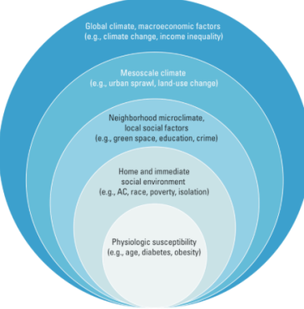
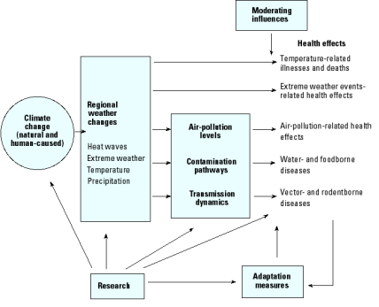
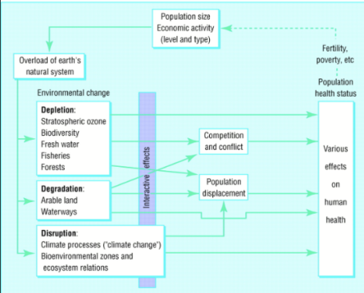
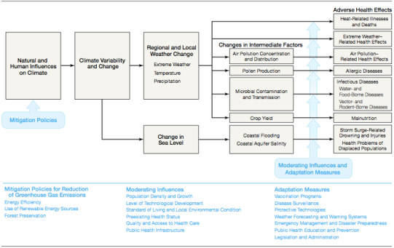
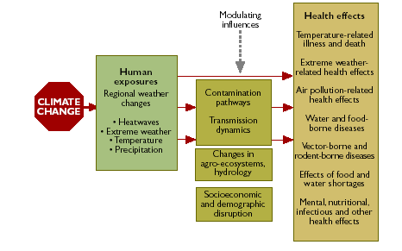
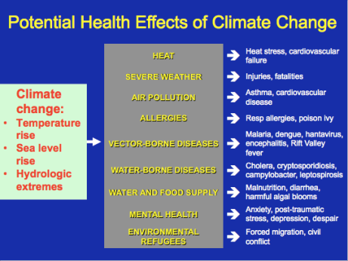
Patz, EHP 2000
Hess, NIEHS
McMIchael 1997
Patz, 1998
Haines & Patz 2004
WHO
Notes:
And many frameworks looking at climate change and health
We chose Haines and Patz because easy to understand, and similar in structure to BARHII

Slide 11
Haines & Patz, 2004

Slide 12
Extreme weather/storms
Climate Variability and Change

Slide 13
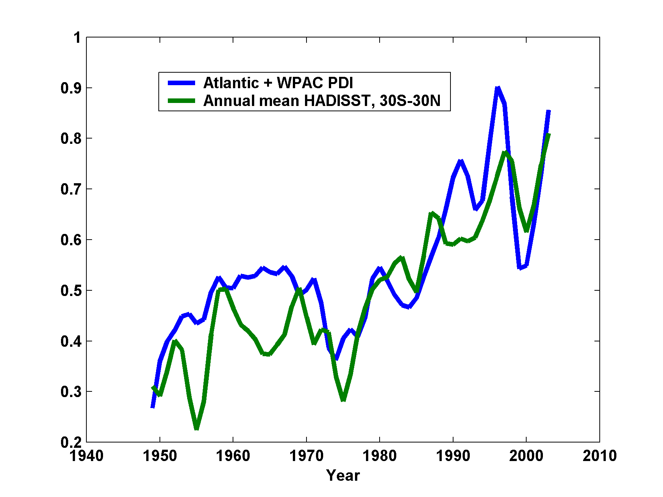
Hurricane Strength & Sea Surface Temps.
Emanuel, 2005
Notes:
Annually accumulated power dissipation index (PDI) for the western North Pacific and North Atlantic, compared to annually averaged sea surface temperature (Hadley Centre SST or HadlSST). Both time series have been transformed to facilitate comparison. Source: Emanuel 2005.

Slide 14
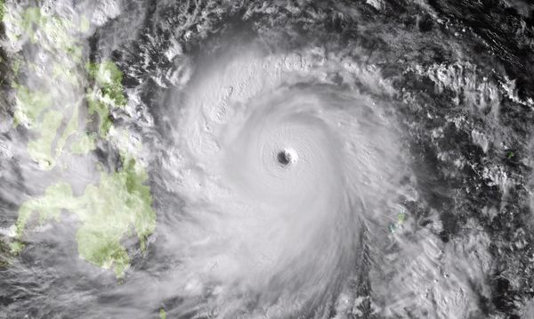
Typhoon Haiyan Philippines, Nov. 8, 2013

Slide 15
temperature
Climate Variability and Change

Slide 16
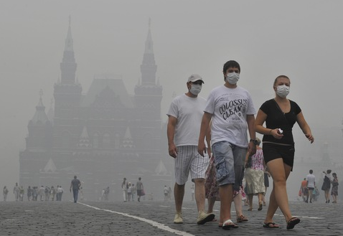
Russia 2010:
1 month heatwave (>100°)
55,000 excess deaths
1 million acres burnt
25% drop in crop yields
US$15 billion loss
'Mega-heatwaves' such as the 2003 and 2010 events broke the 500-yr long seasonal temperature records over 50% of Europe. Probability of 'mega-heatwaves’ will increase by a factor of 5 to 10 within the next 40 years.
Barriopedro et al Science 21 March 2011 10.1126/science.1201224
Courtesy: Alistair Woodward

Slide 17
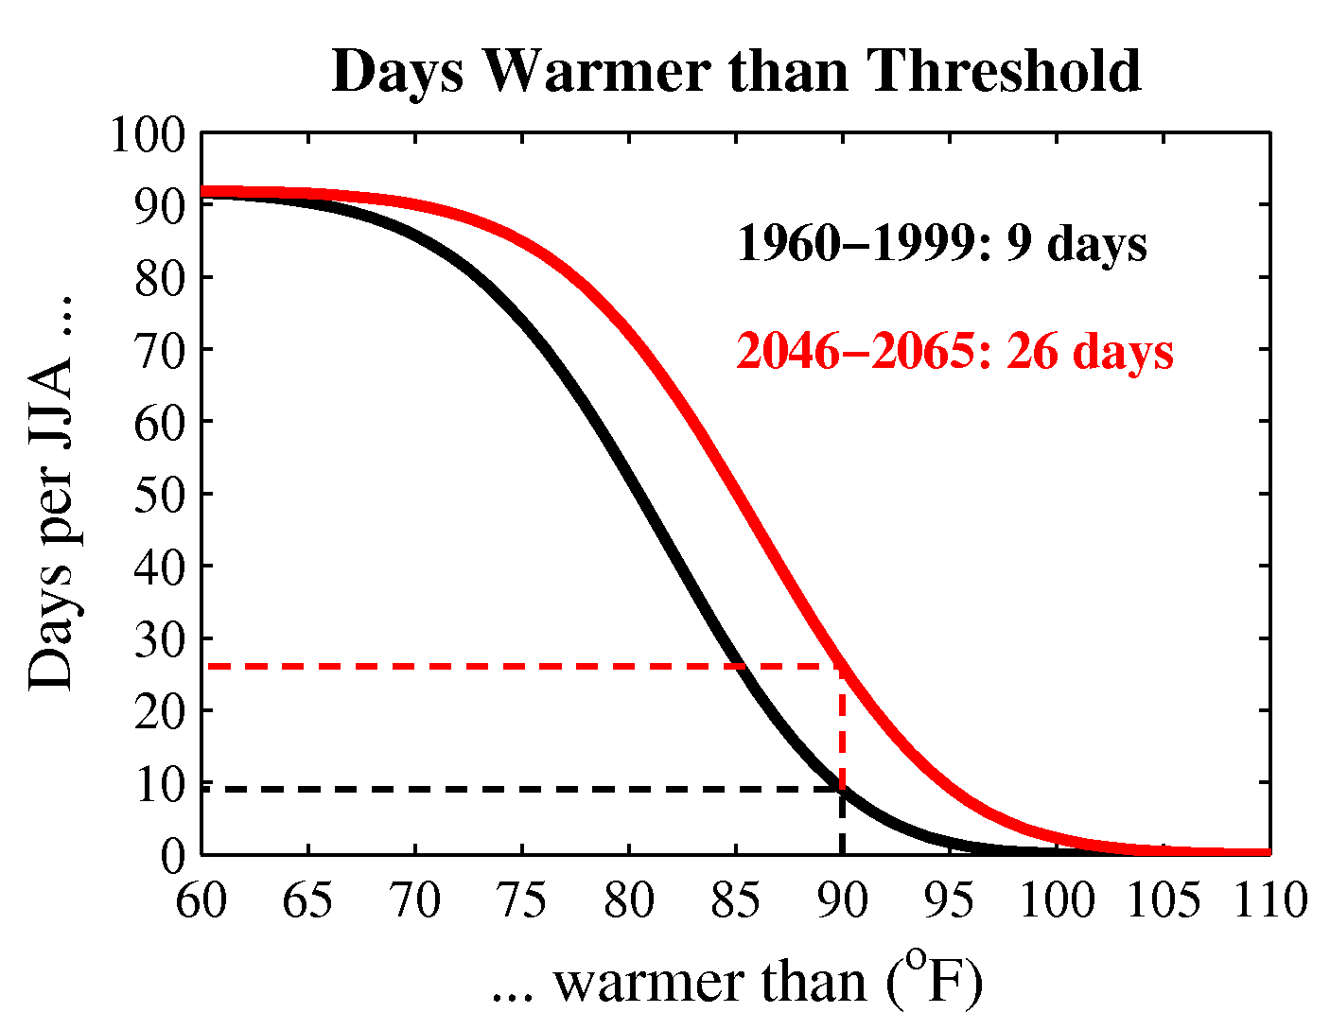
Future Extreme Heat - Wisconsin
Courtesy: Dan Vimont, PhD
Notes:
Since 1982, extreme heat has caused more deaths in WI than all other natural disasters combined.

