Slide 1
A Public Health Framework for Reducing Health Inequities
Sandi Gálvez, MSW
Executive Director
Notes:
Thanks for giving me opportunity to share our work with you

Slide 2
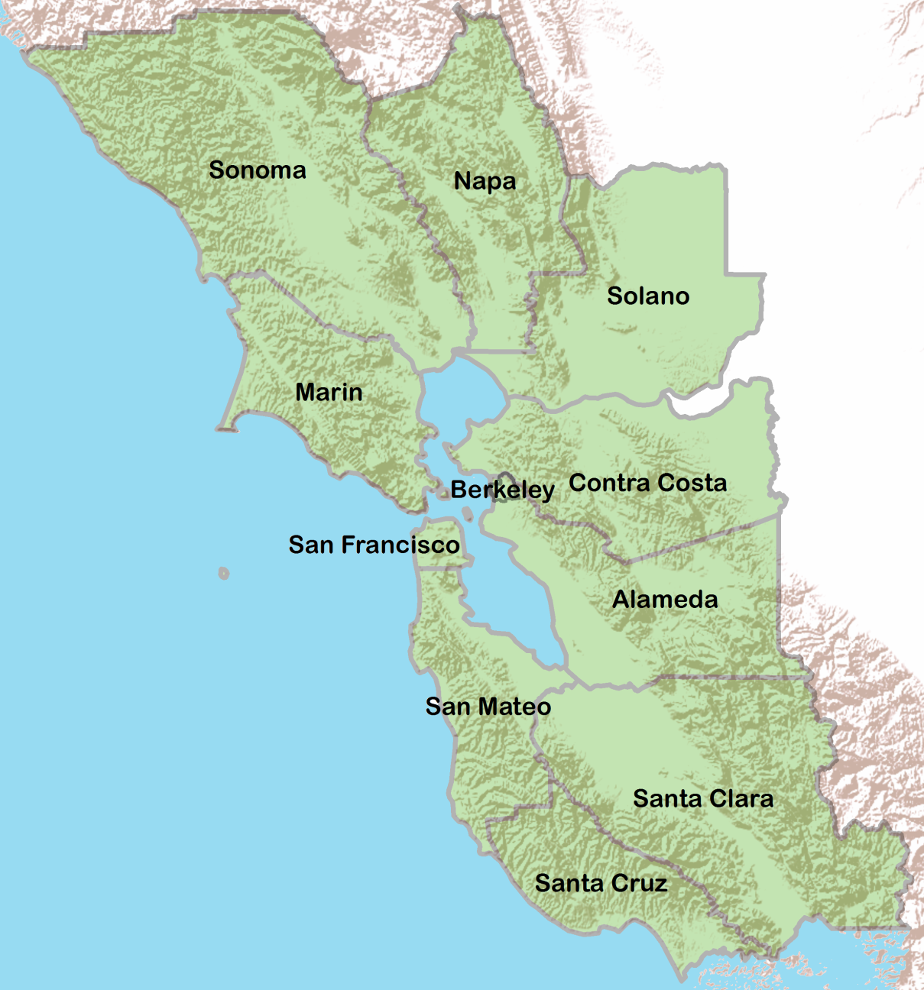
MISSION STATEMENT
To transform public health practice for the purpose of eliminating health inequities using a broad spectrum of approaches that create healthy communities.
Notes:
2
2

Slide 3
CURRENT PUBLIC HEALTH PRACTICE
?
RISK BEHAVIORS
Smoking
Poor Nutrition
Low Physical Activity
Sexual Behavior
Violence
Alcohol & Other Drugs
DISEASE & INJURY
Communicable Disease
Chronic Disease
Injury (Intentional & Unintentional)
MORTALITY
Infant Mortality
Life Expectancy
Notes:
3

Slide 4
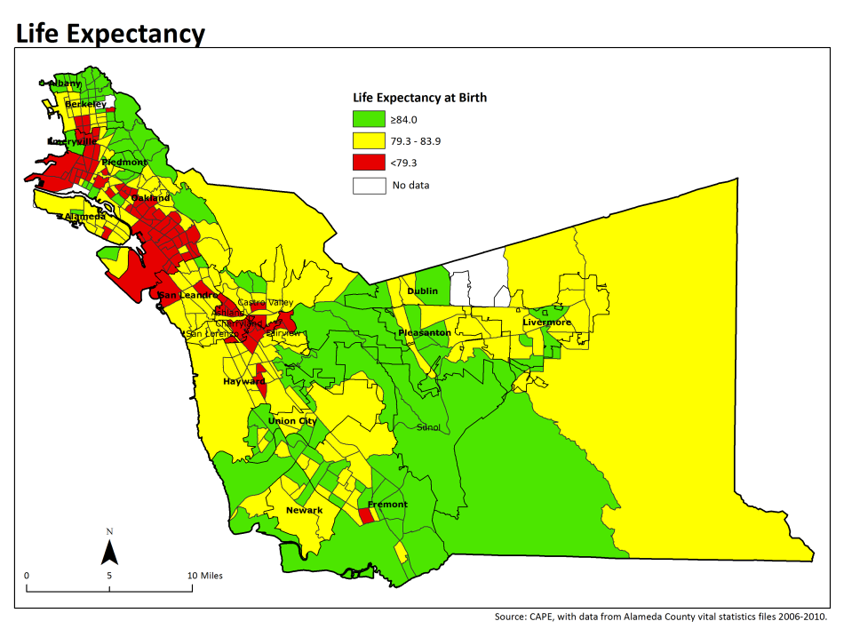
All Green Areas
High school grads: 92%
Unemployment: 6%
Poverty: 7%
Home ownership: 65%
Non-White: 58%

Slide 5
All Yellow Areas
High school grads: 87%
Unemployment: 8%
Poverty: 10%
Home ownership: 55%
Non-White: 63%

Slide 6
All Red Areas
High school grads: 74%
Unemployment: 12%
Poverty: 21%
Home ownership: 35%
Non-White: 82%

Slide 7
Health Inequities in the Bay Area

Slide 8
CURRENT PUBLIC HEALTH PRACTICE
?
LIVING CONDITIONS
Physical Environment
Social Environment
Economic & Work Environment
Services Environment
RISK BEHAVIORS
Smoking
Poor Nutrition
Low Physical Activity
Sexual Behavior
Violence
Alcohol & Other Drugs
DISEASE & INJURY
Communicable Disease
Chronic Disease
Injury (Intentional & Unintentional)
MORTALITY
Infant Mortality
Life Expectancy
Notes:
8

Slide 9
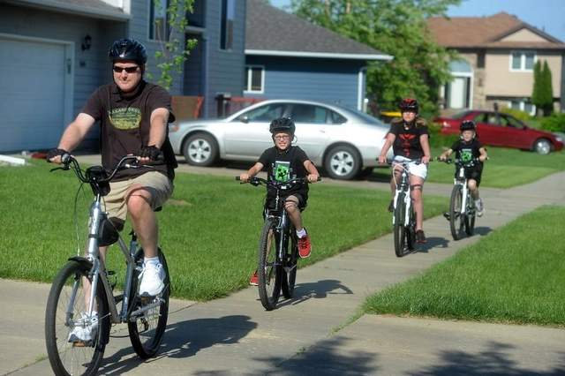
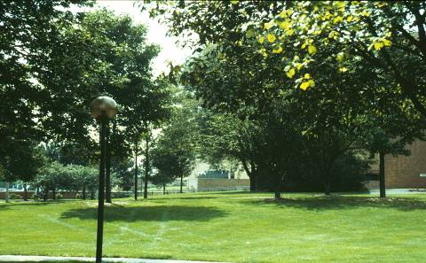
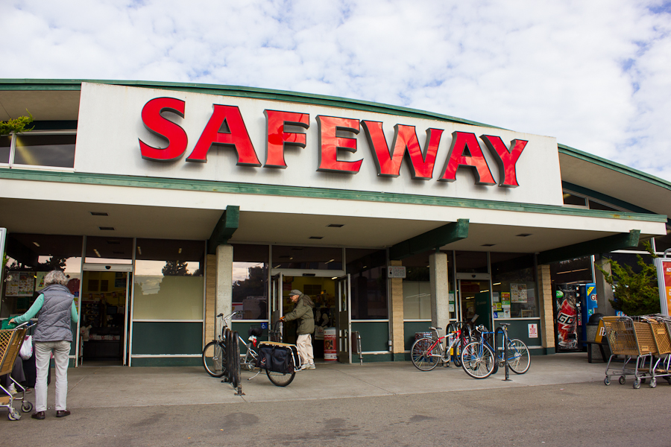
The Neighborhood Context

Slide 10
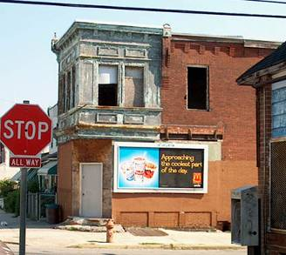
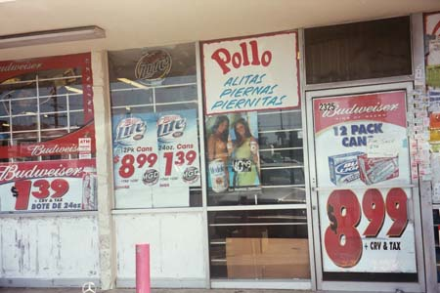
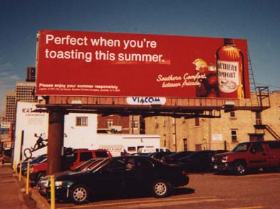

Slide 11
CURRENT PUBLIC HEALTH PRACTICE
INSTITUTIONAL POWER
Corporations & Businesses
Government Agencies
Schools
Laws & Regulations
Not-for-Profit Organizations
LIVING CONDITIONS
Physical Environment
Social Environment
Economic & Work Environment
Service Environment
RISK BEHAVIORS
Smoking
Poor nutrition
Low Physical Activity
Sexual Behavior
Violence
Alcohol and other drugs
DISEASE & INJURY
Communicable Disease
Chronic Disease
Injury (Intentional & Unintentional)
MORTALITY
Infant Mortality
Life Expectancy
Notes:
11

Slide 12
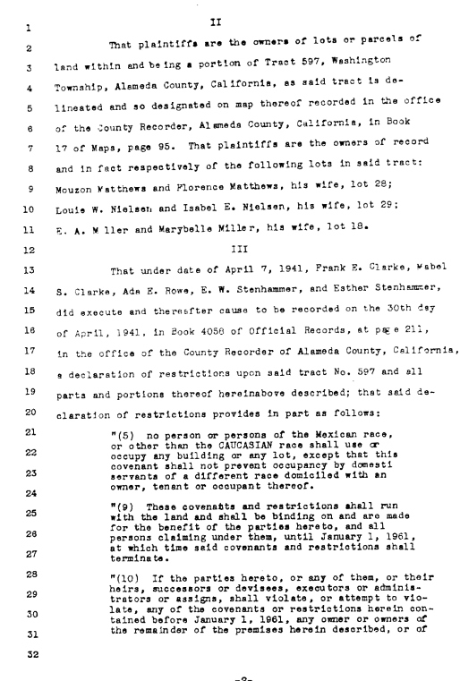
“It is necessary that properties shall continue to be occupied by the same social and racial groups”
Federal Housing Administration Underwriting Manual (1938),
in recommending racially restrictive covenants

Slide 13
EMERGING PUBLIC HEALTH PRACTICE
CURRENT PUBLIC HEALTH PRACTICE
SOCIAL INEQUITIES
Class
Race/Ethnicity
Immigration Status
Gender
Sexual Orientation
INSTITUTIONAL POWER
Corporations & Businesses
Government Agencies
Schools
Laws & Regulations
Not-for-Profit Organizations
LIVING CONDITIONS
Physical Environment
Social Environment
Economic & Work Environment
Service Environment
RISK BEHAVIORS
Smoking
Poor Nutrition
Low Physical Activity
Sexual Behavior
Violence
Alcohol & Other Drugs
DISEASE & INJURY
Communicable Disease
Chronic Disease
Injury (Intentional & Unintentional)
MORTALITY
Infant Mortality
Life Expectancy
Notes:
13
To address the isms and SDOH indicators is to expand beyond the medical model of addressing only individual health outcomes and risk behaviors.
The racial health disparities in health outcomes data that we consistently see across diseases and conditions are generally responded to with individual behavior change and medical interventions. However, in addition, we need to address the multiple factors of the physical and social environment causing these inequities and not just the health and health behaviors of the individual people.

