Slide 1
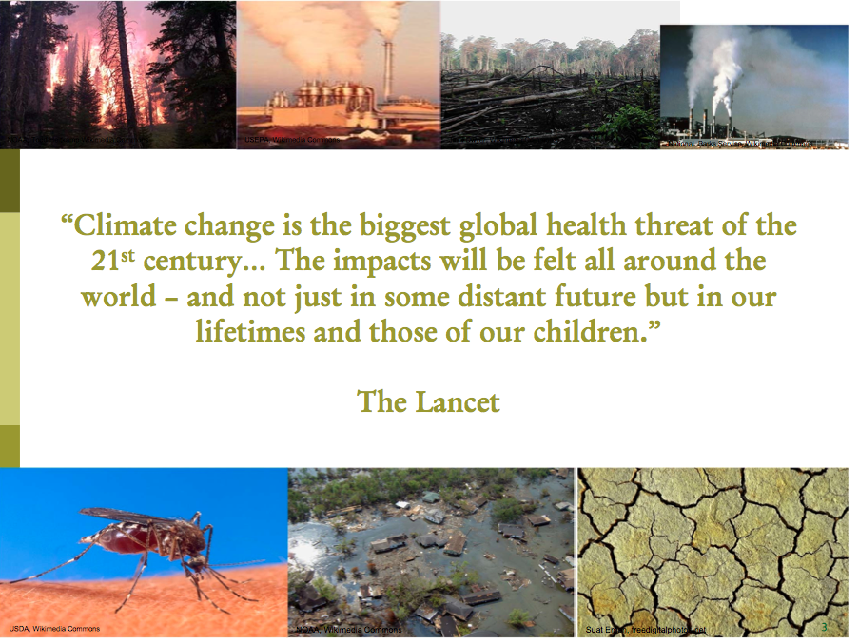
“Climate change is the biggest global health threat of the 21st century.” The Lancet
“ Climate change threatens our fragile existence on this planet.”
Jim Kim, World Bank
“Climate change is affecting agriculture, water resources, human health, and ecosystems on land and in the oceans. It poses sweeping risks for economic stability and the security of nations. We can avert these risks if we take bold, decisive action now.” Ban Ki-Moon

Slide 2
Why aren’t we doing more?
No funding, no resources
No mandate, not our job, silos
Competing priorities
  Tyranny of the urgent
Lack workforce capacity
  Knowledge, expertise
Lack leadership
Unclear exactly how this relates to what we do now
Unclear what exactly we can do
Notes:
Based on our 135 interviews and focus groups

Slide 3
Frameworks can help to:
  Organize our thinking
  Provide a shared understanding of an issue
  Show key factors and variables
  Visualize complex relationships
  Identify opportunities for action

Slide 4
We wanted a framework that explicitly:
Links to current public health thinking and practice
Addresses health inequities and the climate gap
Shows upstream determinants of health
Shows causes of climate change
Helps identify opportunities for intervention across the spectrum of prevention and climate action

Slide 5
How we developed a framework
Review literature and existing frameworks
Focus groups and interviews with 135 people

Slide 6
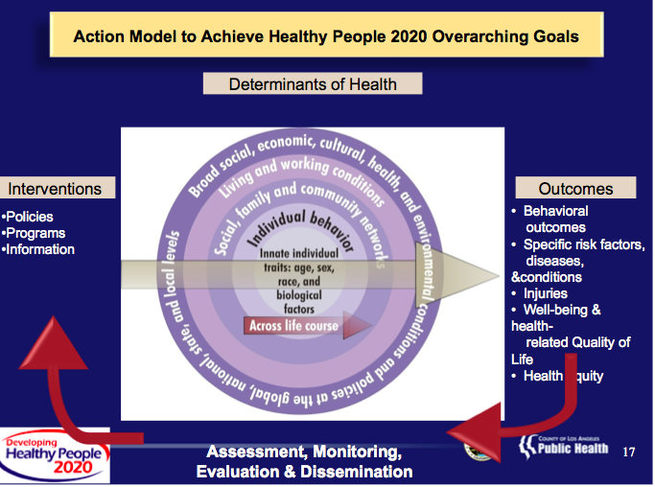
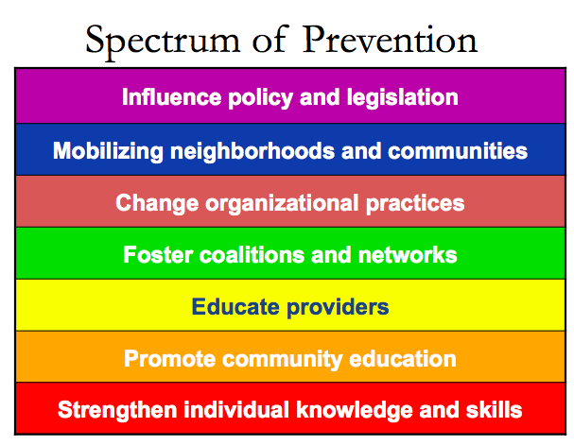
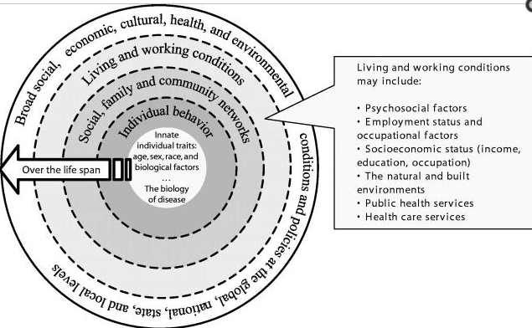
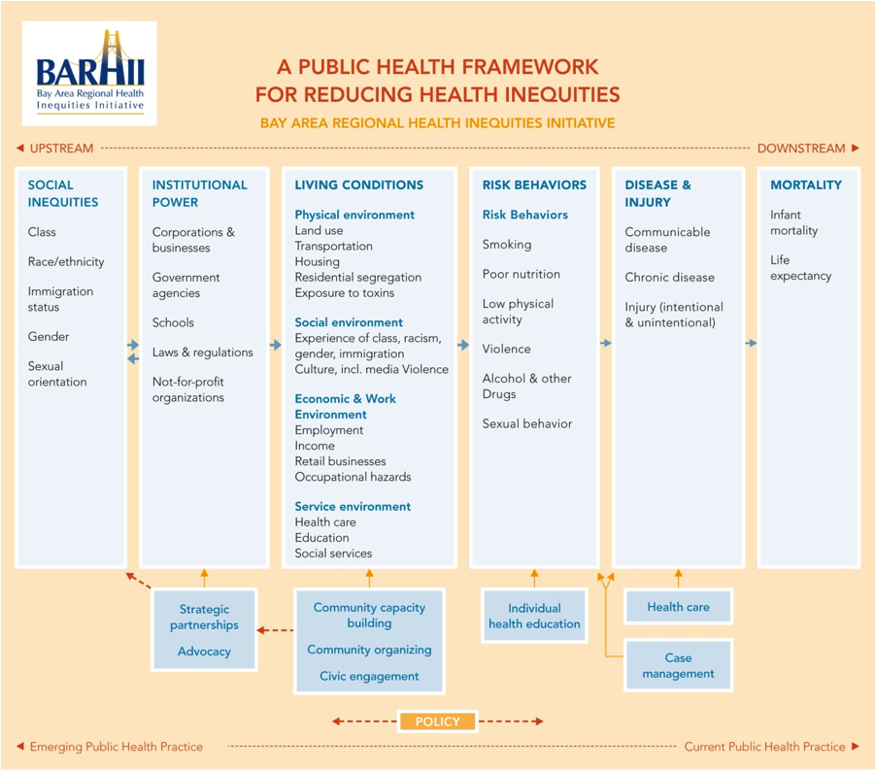
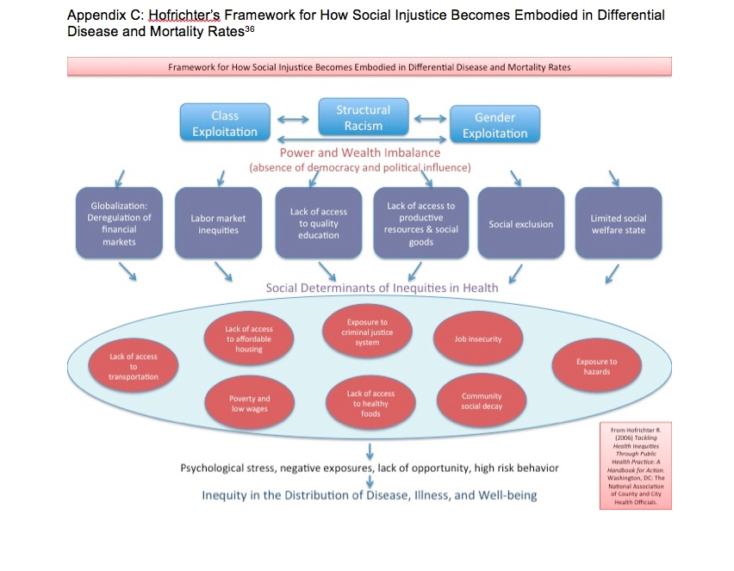
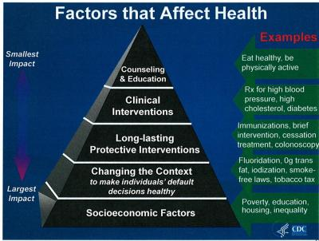
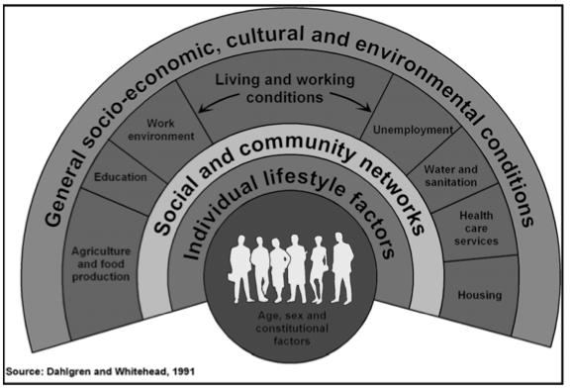
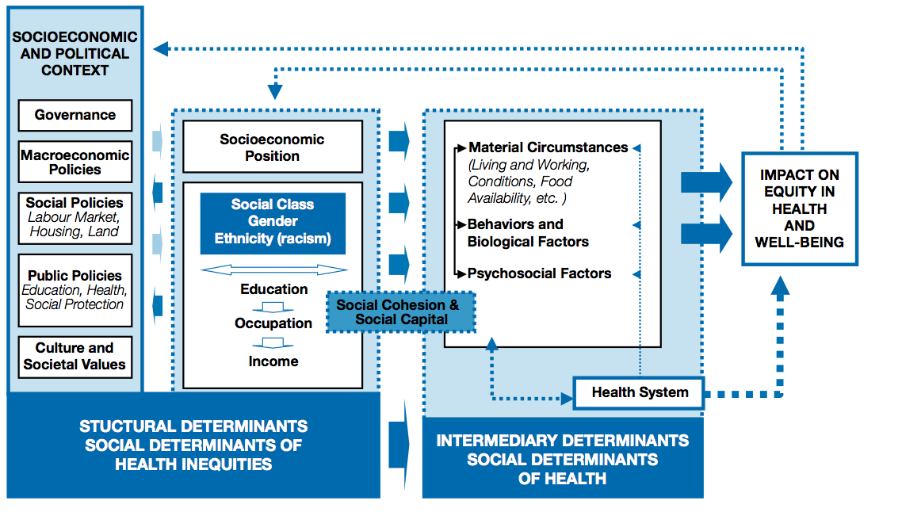
Source: Institute of Medicine, USA
L. Cohen, Contra Costa County Health Services
http://www.who.int/social_determinants/corner/SDHDP2.pdf

Slide 7
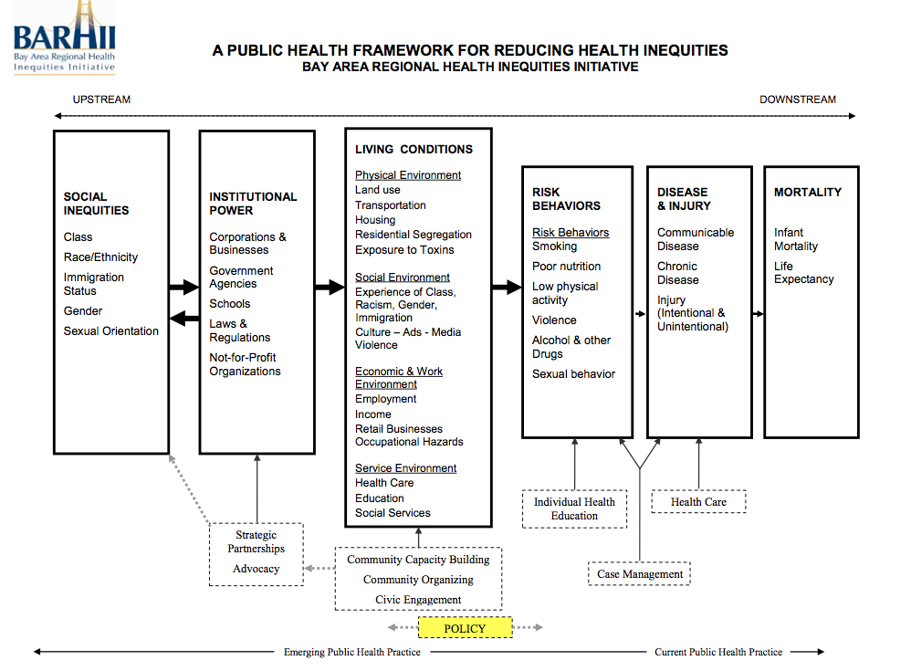

Slide 8
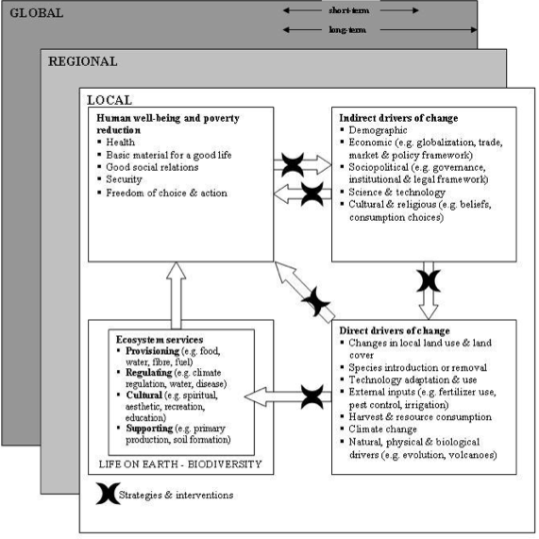
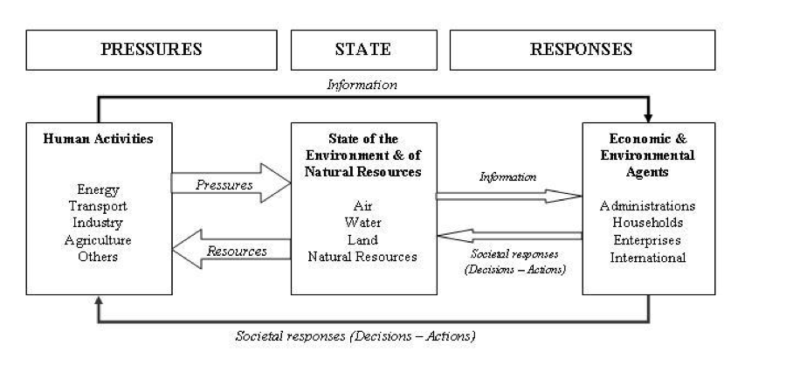
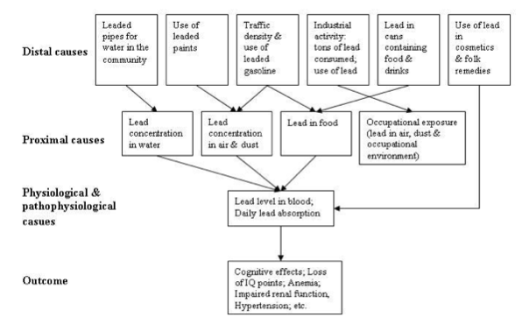
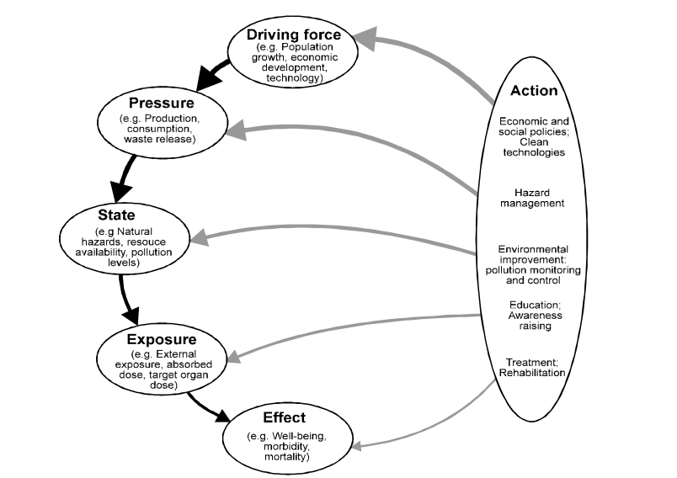
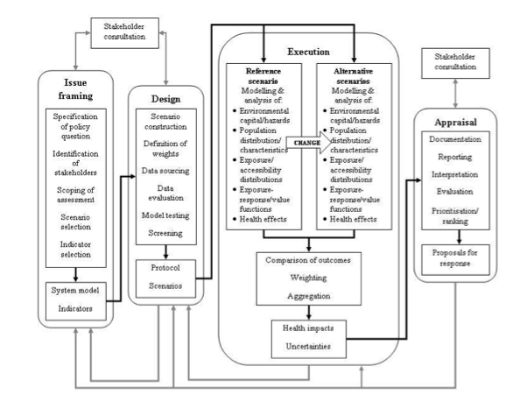
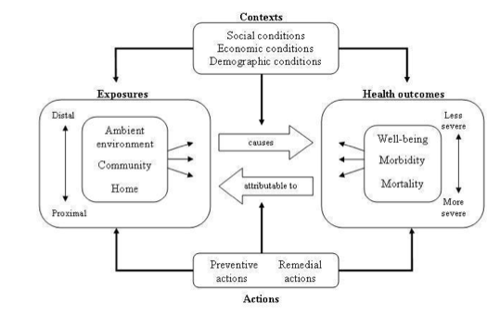
L. Rudolph 12-8-2013
Hambling T. www.ncbi.nlm.nih.gov/pmc/articles/PMC3155333/pdf/ijerph-08-02854.pdf

Slide 9
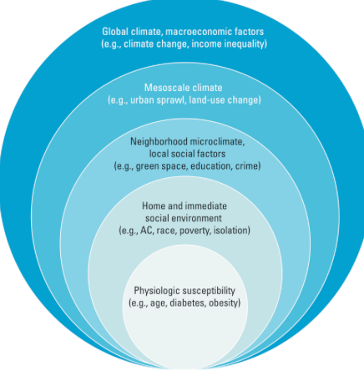
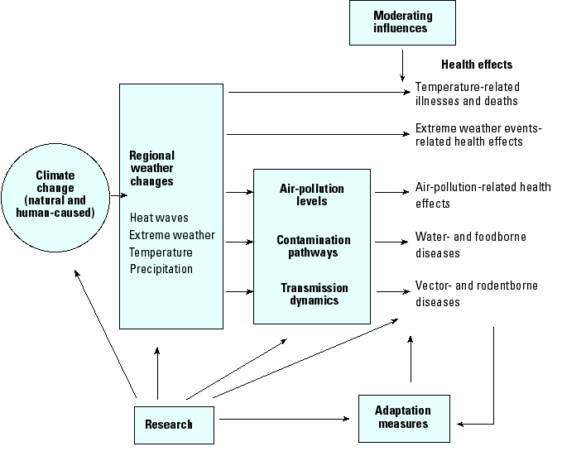
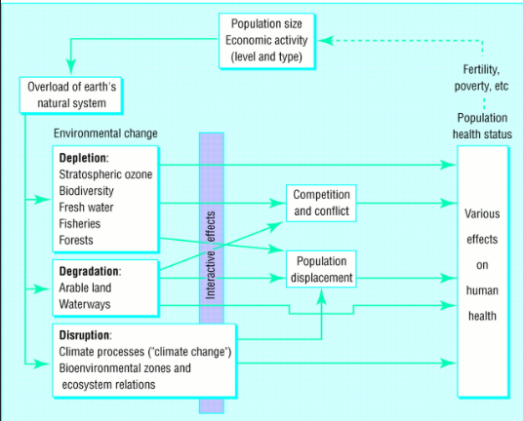
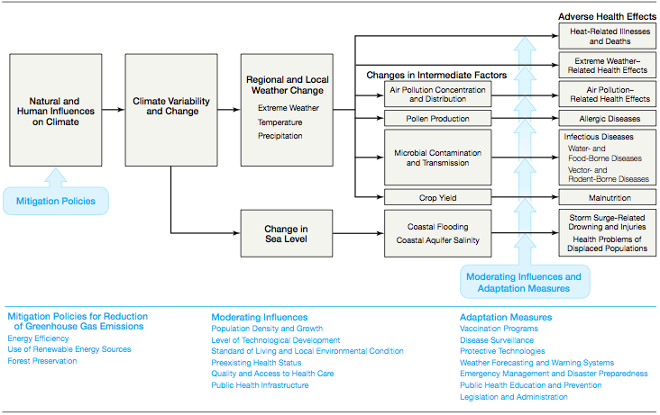
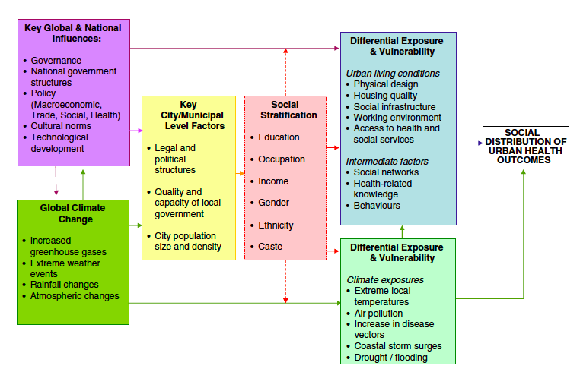
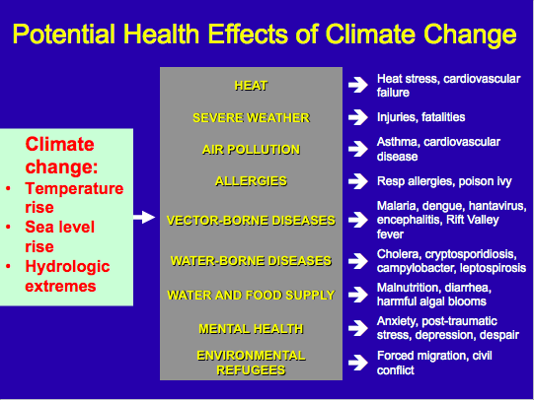
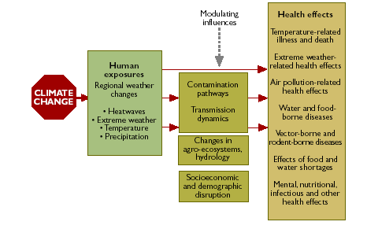
Patz, EHP 2000
Hess, NIEHS
McMIchael 1997
McGeehin CDC
Patz 2000
Friel 2011
WHO

Slide 10
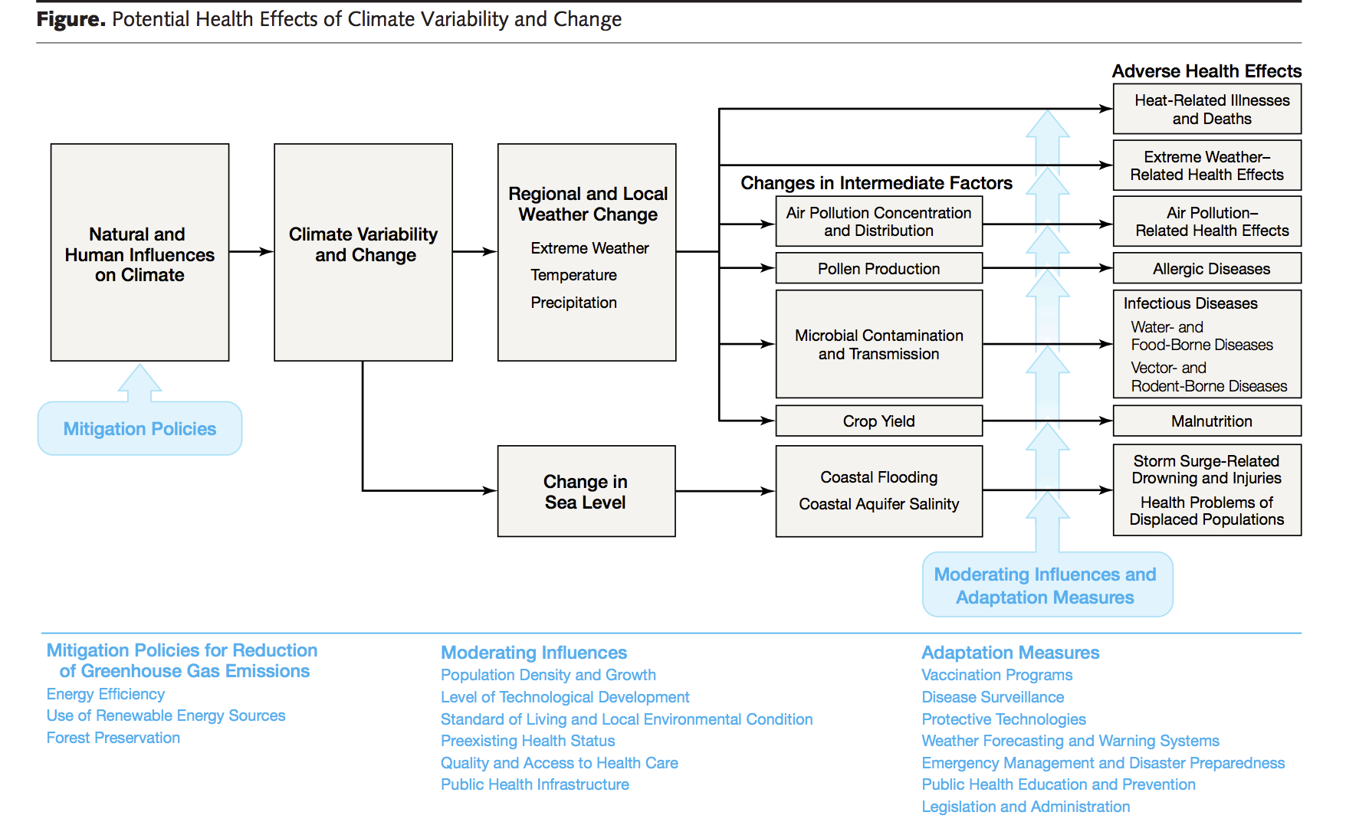
Patz and Haines, JAMA, 2004.
Notes:
.

Slide 11
