Slide 1


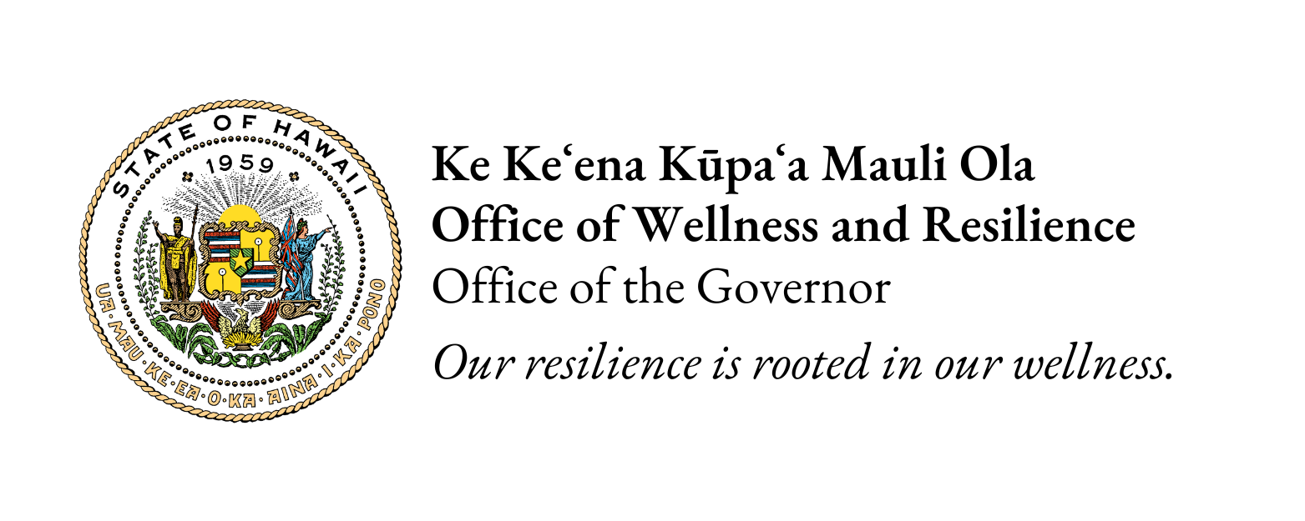

Healing Through Trauma-Informed Care: Elevating the Role of Peer Support in Our Systems
Notes:
Presenter
2023-06-14 03:37:08
--------------------------------------------
Aloha mai kākou, and welcome to “Understanding Cultural Diversity, Inclusion and Equity”. This training was developed for the Hawai‘i Department of Human Services’ Child Welfare Services in partnership with Nā Kama a Hāloa, a network of government, community agencies and people with lived experience. In an effort to effectively serve our kānaka ʻōiwi families, it is imperative for us to understand their history, trauma and cultural perspectives.

Slide 2
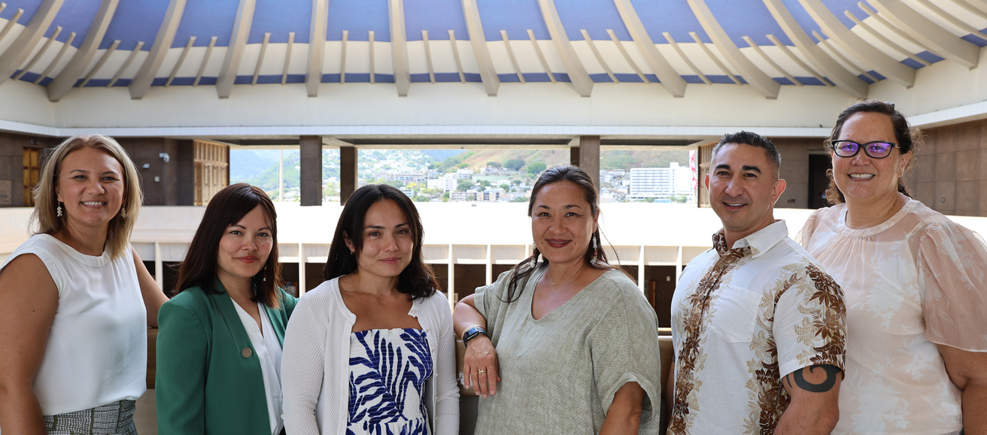
Office of Wellness and Resilience
Established in 2023
The mission of the Office of Wellness and Resilience is to strengthen our state systems and services, using healing-centered care principles as strategies to make Hawai‘i a trauma-informed state.
We break down barriers that impact the well-being of Hawai‘i’s people—from keiki to kūpuna.
Notes:
Brief intro of office. Our mission and mandates.

Slide 3

Trauma-Informed Care
Changing the perspective
from ‘What’s wrong with that person?’
to ‘What happened to them?’
And to their family? Their community?

Slide 4
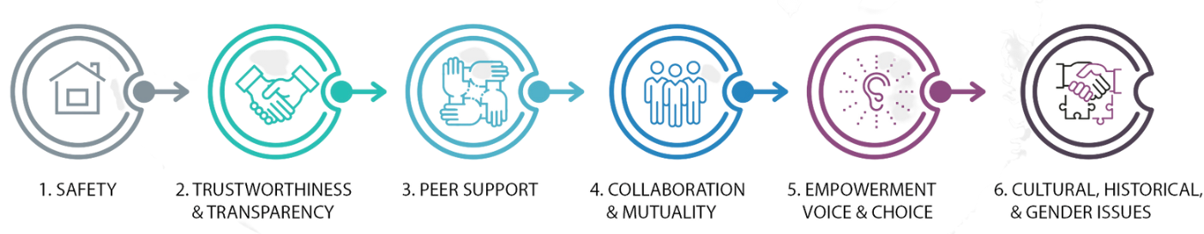
SAMSHA’s Guiding Principles to A Trauma-Informed Approach
S.B. 3094: Peer Support Specialist Working Group
Launch of Learning Collaborative(s)
Peer support as key vehicle for establishing safety and hope, building trust, enhancing collaboration, and utilizing their stories and lived experience to promote recovery and healing.
“Peers” refers to individuals with lived experiences of trauma, or, in the case of keiki, this may be family members of children who have experienced traumatic events and are key caregivers in their recovery.
Notes:
Peer Support is one that OWR is actively working on to elevate.
Brief intro of peer support and their role.
Numerous peer support programs in community. In the State, it’s mainly through DOH AMHD peer specialist program (credentialing and certification).

Slide 5

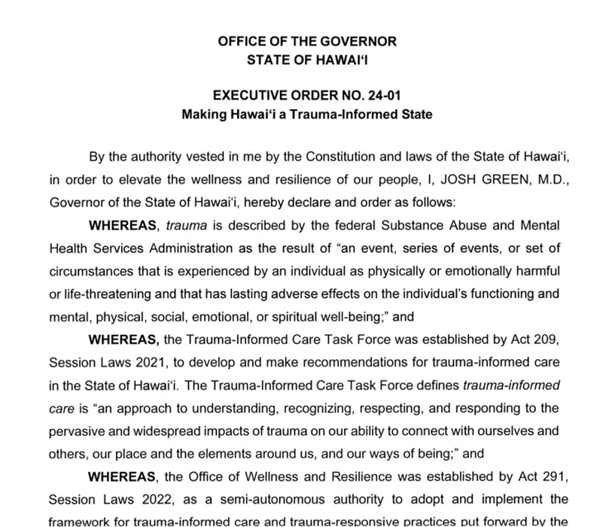
Governor Green’s Declaration
of Hawai‘i ​
as a Trauma-Informed State
Notes:
Presenter
2023-06-14 03:37:17
--------------------------------------------
For Native Hawaiians and many other peoples, because traditions and cultural practices are timeless, they serve many purposes-
• Builds upon identity
• Helps make connections with our piko, helps us recall upon our ancestral memory
• Provides a sense of belonging
• Strengthens purpose
• Perpetuates practices
Replaces the hurt caused by Historical trauma and traumatic experiences and creates a renewed positive trajectory for future generations. HEALS
We have seen a lively resurgence of Native Hawaiian culture and practices, we are witnessing a cultural endurance and resiliency. We (Native Hawaiians) have been wounded, have scars, but WE ARE STILL HERE!

Slide 6

Act 88: Peer Support Specialist Working Group
Establishes a Peer Support Specialist Working Group within OWR, consists of several state departments, community partners and peers
Will develop and make recommendations for a framework for peer support specialists in the State
Will examine best practices of certifying and credentialing peers, trauma-informed supervision and sustainable funding to support the work of peer support specialists statewide
Notes:
How can the state elevate and support peers? How do we acknowledge and compensate their work that is as worthy, if not more than, academic credentials?

Slide 7



​Today's Panelists:
Asha (Sasha) Autele
Parent Peer Support, EPIC ’Ohana, Inc.
Kailene Nihipali Sanchez
Nā Kama a Hāloa Manager, EPIC ’Ohana, Inc.
Kimmy Takata
Forensic Peer Specialist Coordinator, Pu’a Foundation
Notes:
Presenter
2023-06-14 03:37:09
--------------------------------------------
In Hawaiʻi, Hawaiian Culture is not only our host culture, but our Root Culture. We believe that if we honor the practices and values of our root culture and of our ‘āina, then our Kānaka ʻōiwi will thrive.
The wellbeing of Kānaka ʻŌiwi is intrinsically tied to the relationships to ʻāina - the land, to Akua - to God and to kānaka - other human beings. In this section, we will lay a foundation to understand the importance of these relationships.

Slide 8
Families are the foundation of our community, and their well-being is inextricably linked to the health and prosperity of the community, state, and nation.
EPIC ‘Ohana, Inc. works to strengthen ‘ohana and enhance the welfare of children and youth through transformative processes that are respectful, collaborative and solution-oriented.
EPIC = Effective Planning & Innovative Communication

Slide 9

Nā Kama a Hāloa is a community-based network that first came together in September 2018.
We work to weave Native Hawaiian wisdom and perspective into the Hawai‘i foster care system.
We strive to share power among representatives of Native Hawaiian serving institutions, the state Child Welfare Services, contracted service providers,
and birth parents and youth with lived experience in child welfare.
Our efforts improve outcomes for Native Hawaiian children and families involved in the
child welfare system.
Goal:
By the year 2030, Native Hawaiian children are no longer disproportionately
represented in child welfare.

Slide 10

Recovering from trauma can be challenging,
but recovery is possible.
Our strategy to support women/girls/families,
especially Hawaiians, is:
1) We start inside the prison or facility pre-transition, then connect resources post-transition - creating a seamless continuum of care;
2) We have established key strategic public/private, faith-based & community partnerships, and
3) We incorporate peer support as a key trauma-informed care element.
We have been working with the Women’s Community Correctional Center (WCCC) since 2007; we were on the leadership team for the Trauma Informed Care Initiative at WCCC - 2011 & 2012;
we led the Trauma Informed Care Initiative at Family Court,
involving Kapolei Juvenile Detention Center,
Hawai‘i Youth Correctional Facility & Home Maluhia Shelter - 2013;
we’ve been working at the Federal Detention Center since 2016.
Trauma to Transformation
Incarceration to Independence

Slide 11

Mahalo!
Naomi Leipold​
Project Manager (Policy Lead), OWR​
naomi.t.leipold@hawaii.gov
Kailene Nihipali Sanchez​
Nā Kama a Hāloa Manager, EPIC 'Ohana​
knihipalisanchez@epicohana.org
Kimmy Takata​
Forensic Peer Specialist, Pu’a Foundation​
kimmy.takata@puafoundation.net
Asha (Sasha) Autele​
Parent Peer Support, EPIC 'Ohana​
sautele@epicohana.org
Notes:
Presenter
2023-06-14 03:37:29
--------------------------------------------
Mahalo piha!

