Slide 1


Leveraging Community and Cultural Strengths to Achieve Health Equity for Pasifika:
Lessons from the HELA and KāHOLO Projects
AANHPI Trauma-Informed Care & Other Services: Bridging Community- and Evidence-Based Practices
August 1, 2024 at East-West Center
Keawe‘aimoku Kaholokula, PhD
Professor and Chair, Principal Investigator
Department of Native Hawaiian Health
John A. Burns School of Medicine
University of Hawai‘i at Manoa
kaholoku@hawaii.edu

Slide 2
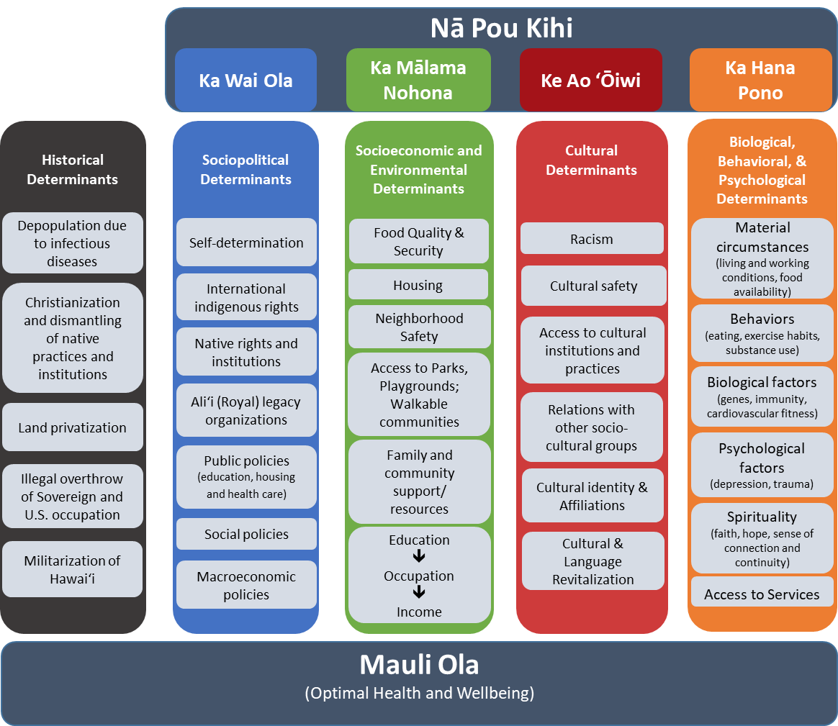
Mohala i ka wai, ka maka o ka pua
Flowers thrive where there is water, as thriving people are found where living conditions are good

Slide 3
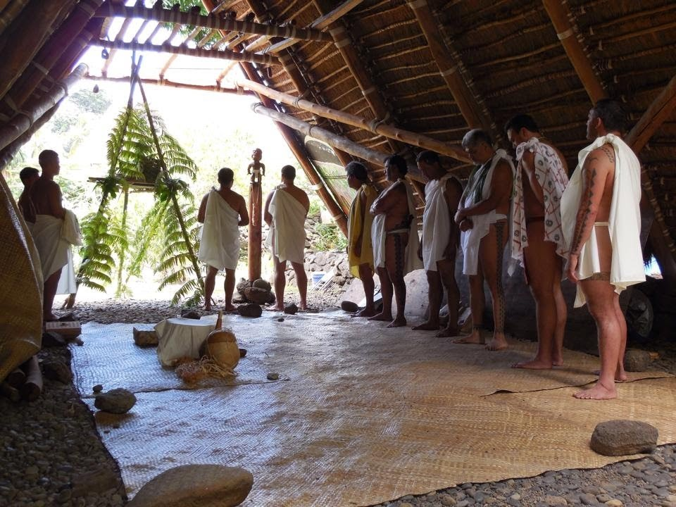
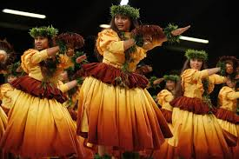
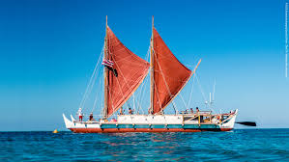
Cultural Assets & Aspirations
Kānaka ‘Ōiwi are (re)turning to cultural perspectives and traditions to achieve Mauli Ola.
Revitalizing traditional practices (e.g., language; traditional diets and resource management; and ocean voyaging traditions).
93% strongly identify with their Kanaka ‘Ōiwi heritage and culture (Kaholokula, 2017).
80% strongly believe it is important to maintain cultural values and practices for psychological wellbeing (Kamehameha Schools, 2014).
Culture-based educational strategies lead to better academic performance, education and community engagement, and greater cultural pride (Kana‘iaupuni & Ishibashi, 2003, 2005).
Desire for holistic approaches to healthcare and health promotion (Kaholokula et al., 2008; Maskarinec et., 2015).
Nānā i ke kumu.
Look to the source.

Slide 4
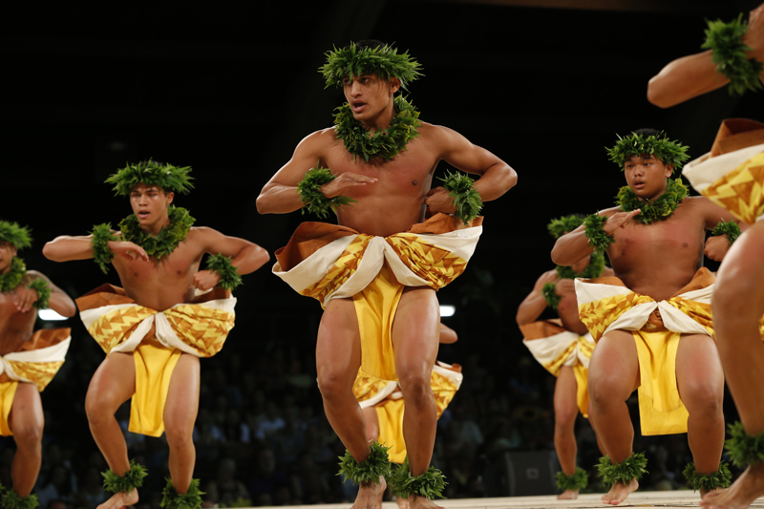
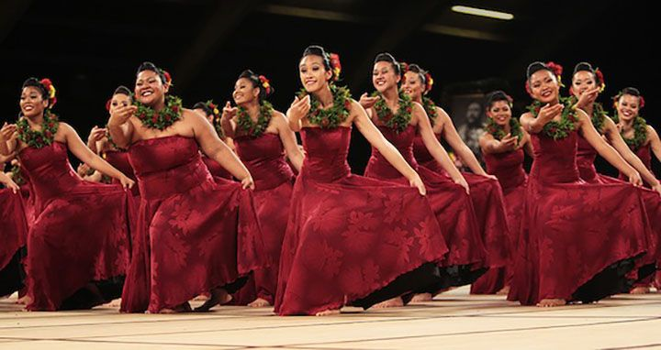
Hula, a Hallmark of Hawaiian Culture
“Hula is the language of the heart, therefore, the heartbeat of the Hawaiian people..”
− King David Kālakaua
Hula kahiko or ancient hula
“Hula is our highest expression of who we are. It’s our language put into motion.”
− Māpuana de Silva
Hula ‘auana or modern hula
Notes:
Conveys history, ancestral stories, spiritual beliefs, and one’s connection to the natural world.
Can vary in intensity/duration depending on the choreography, tempo of the music, and physical capacity of the dancer.
From a sacred religious practice to a tourist attraction, along the way falling prey to cultural appropriation and near erasure.
It Is comprised of specific controlled rhythmic movements that illustrate the meaning or poetry of the accompanying songs or chants

Slide 5
Prevalence of Hypertension and CVD
Hypertension (high blood pressure) is modifiable risk factor for heart disease, stroke, and ADRD.
Compared to Whites, NHPI are…
  70% more likely to have hypertension;
  Less likely to receive adequate hypertension treatment;
  3 to 4 times more likely to have heart disease and stroke;
  Having chronic disease at younger ages (Aluli et al., 2010; Nakagawa et al., 2021).
Hypertension and CVD risk Is associated with the experience of racism in NHPI (Ing et al., 2019; Hermosura et al., 2018; Kaholokula et al., 2010).
Notes:
, accounting for nearly 50 % of ischemic strokes [2].

Slide 6

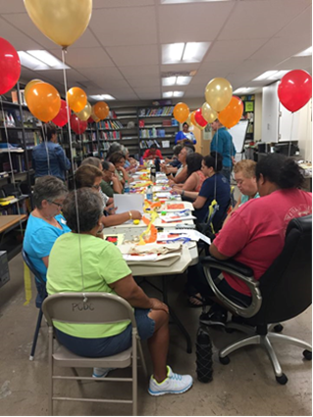
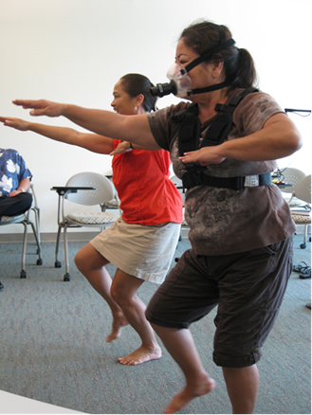
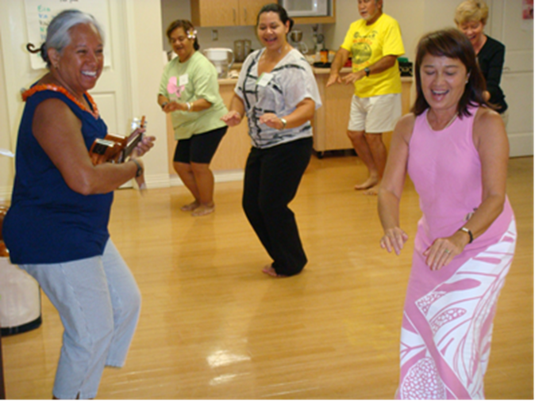
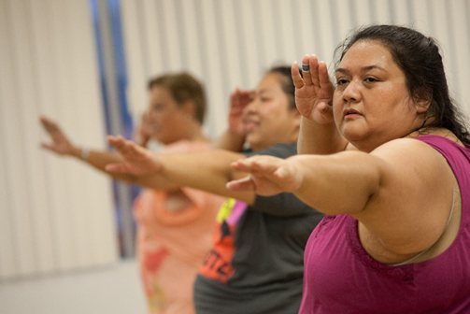
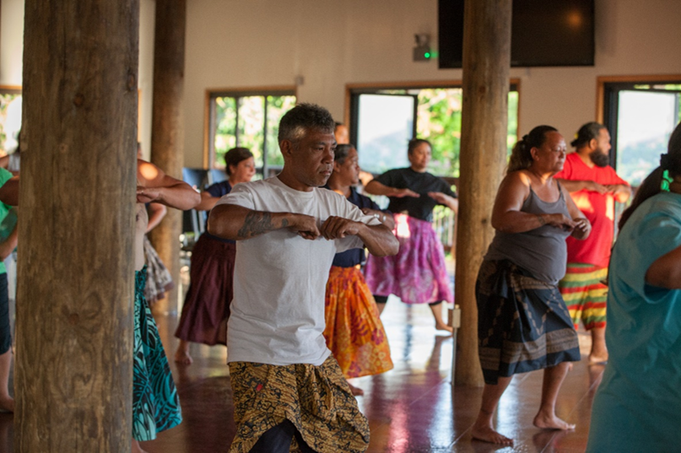
From left to right in foreground: Māpuana de Silva (hula expert) and Mele Look (co-Investigator)

Slide 7

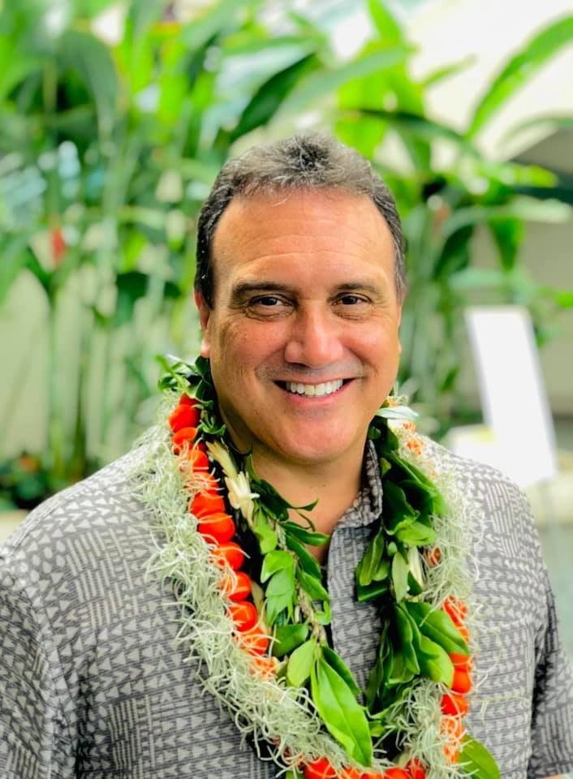
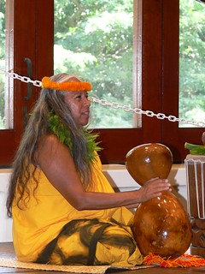
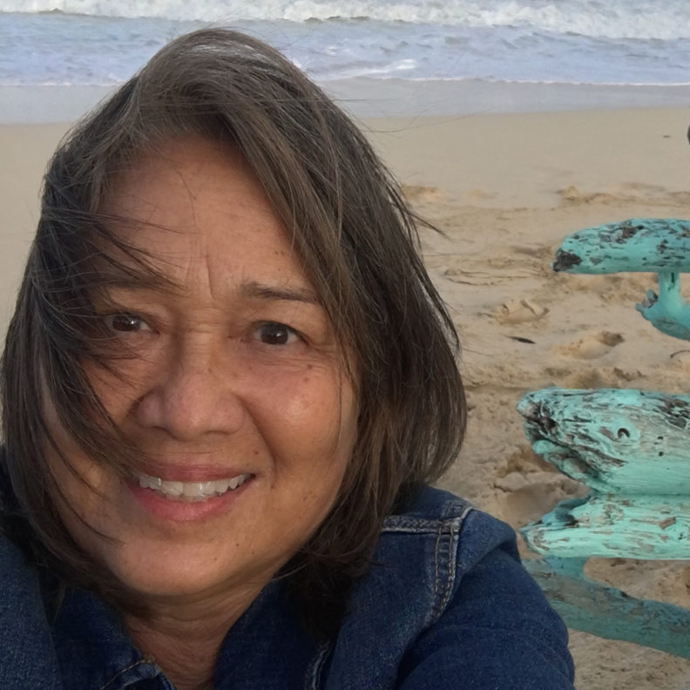
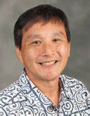
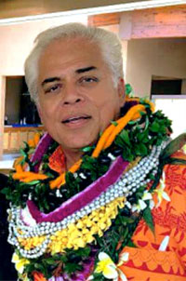
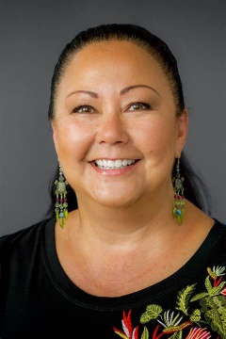

Investigative Team
Multi-disciplinary team
Medical, behavioral, and community researchers and clinicians.
Cultural experts.
Mele Look, MBA, MPH
Researcher and hula Practitioner
Keawe‘aimoku Kaholokula, PhD
Clinical psychologist and cultural practitioner
Māpuana de Silva
Hula master and cultural practitioner
Todd Seto, MD
Cardiologist
‘A‘ohe pau ka ‘ike i ka hālau ho‘okahi.
Not all knowledge can be obtained from a single school.
Ka‘imi Sinlair, PhD
Indigenous health researcher
Cy Bridges
Hula master and cultural practitioner
Gregory Maskarinec, PhD
Cultural Anthropologist

Slide 8
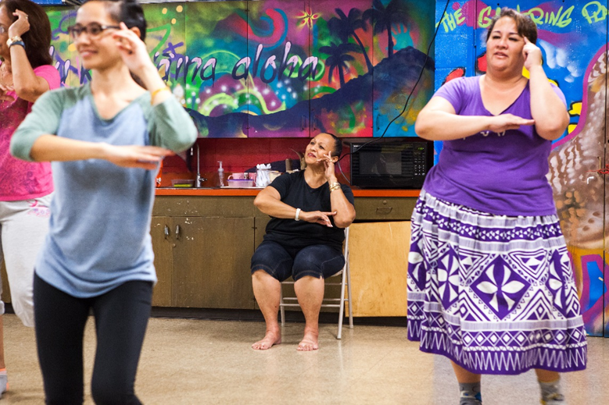
Formative Research
Determine the cultural acceptability and relevance of using hula to address CVD form the perspectives of ….
  Keeper of the hula tradition
  Native Hawaiian patients and their families.
Both kuku hula, patients, and family agreed that hula offers a holistic approach to health promotion.
    Cultural
    Spiritual
    Emotional
    Social
    Physical level
R01HL126577 (Kaholokula)

Slide 9
Metabolic Equivalence of Hula
Activity | METs
Resting | 1.0
Walking (20 min/mile, level and firm surface) | 3.3
Gardening (general) | 4.0
Dancing (ballroom, fast) | 5.5
Basketball (general) | 6.0
Tennis (general) | 7.0
Basketball or Volleyball (game) | 8.0
Soccer (game) | 10.0
low Intensity hula (5.7)
Hula 6.6
high intensity hula (7.5)
Ainsworth, BE et al (2000). Compendium of physical activities: an update of activity codes and MET intensities. Med Sci Sports Exerc, 32(9 Suppl), S498-504.
Usagawa, T, et al. (2013). Metabolic equivalent determination In the cultural dance of hula. Int J Sports Med, 35(5), 399-402.
Notes:
One metabolic equivalent (MET) is defined as the amount of oxygen consumed while sitting at rest and is equal to 3.5 ml O2 per kg body weight x min. The MET concept represents a simple, practical, and easily understood procedure for expressing the energy cost of physical activities as a multiple of the resting metabolic rate.

Slide 10
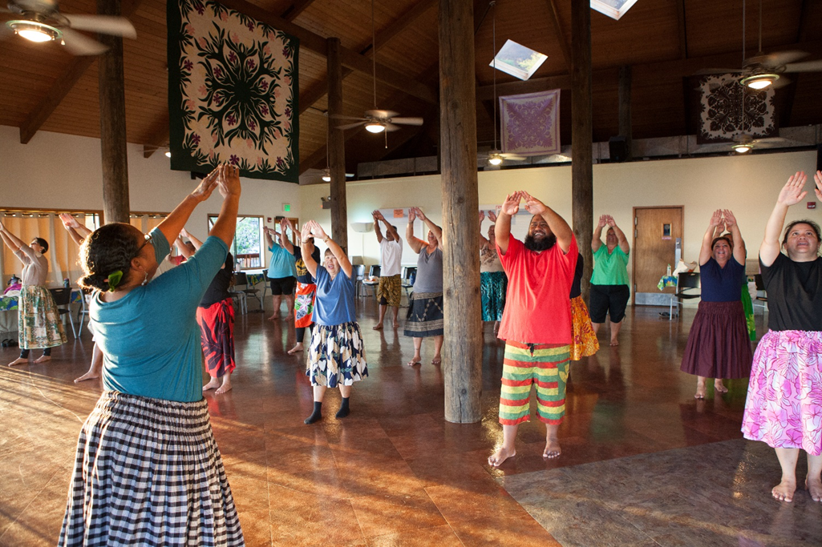
Hula Training Protocols
Two 60-min. Hula classes per week for 12-weeks
  ~15 participants per cohort
  Led by a kuku hula trained on standardized protocols.
Goal of each hula class was to Increase minutes of continuous dancing.
R01HL126577 (Kaholokula)
Notes:
VO₂ max refers to how much oxygen your body can absorb and use during exercise. It measures …
If you’re looking to improve your aerobic fitness, you might consider maximizing your VO₂ max (sometimes called your oxygen uptake).

Slide 11
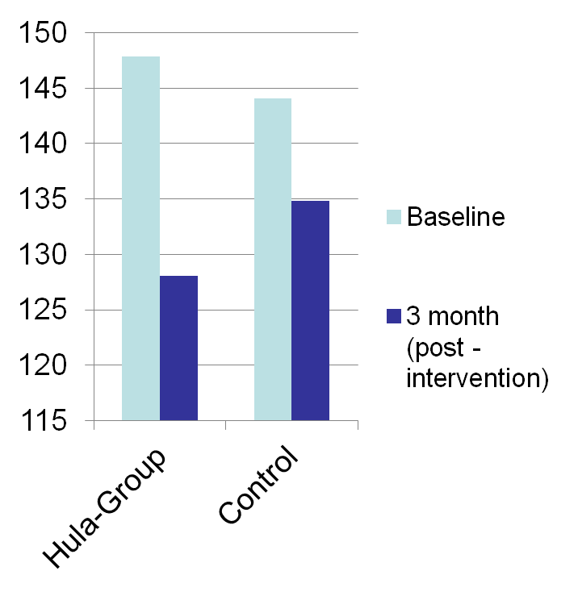
Pilot Controlled Trial
Change in Systolic Blood Pressure (mm Hg)
55 Native Hawaiians and Chuukese adults with uncontrolled hypertension (SBP > 140 mm Hg).
Greater reduction in SBP for intervention group (p = .04).
  Hula group -20 mmHg
  Control -9 mmHg
72% of intervention group dropped ≥ 10mmHg vs. 39% of control (p = .022).
Intervention led to significant Improvements in social functioning, bodily pain, and lower perceived racism.
N = 27
N = 28
Kaholokula, J.K., et. (2017). Cultural dance program improves hypertension management for Native Hawaiians and Pacific Islanders: A pilot randomized trial. Journal of Racial and Ethnic Health Disparities, 4(1), 35-46.

Slide 12
KāHOLO Project: A 5-Year Trial
  Specific Aim 1: Compare the efficacy of a 6-month intervention using hula plus self-care education to a wait-list control group in reducing SBP among NH with physician-diagnosed HTN.
  Specific Aim 2: Compare CVD risk scores in the hula plus self-care education and wait-list control conditions post-Intervention and at 12 month follow-up.
  Specific Aim 3: Test whether intervention effects are mediated through psychosocial and cultural factors.
Kaholokula, J.K., Look, M., Wills, T.A., de Silva, M., Mabellos, T., Seto, T.B., Ahn, H.J., Sinclair, K.A., & Buchwald, D. (2017). Kā-HOLO Project: A protocol for a randomized controlled trial of a native cultural dance program for cardiovascular disease prevention In Native Hawaiians. BMC Public Health, 17, 321.
R01HL126577 (Kaholokula)

Slide 13
Community Partners
Academic Investigators:
  Mele Look, MBA, University of Hawai‘i
  Thomas Wills, PhD, University of Hawai‘i
  Todd Seto, MD, MPH, Queen’s Medical Center
  Ka‘imi Sinclair, MPH, PhD, Washington State University
External Scientific and Cultural Advisors
  Cy Bridges, Kumu Hula
  Karina Walters, PhD , University of Washington
  Dedra Buchwald, MD, Washington State University
  Barbara Howard, MD, Georgetown University
  Fredric Pashkow, MD
Biostatistical Support:
  Hyeong Jun Ahn, PhD, University of Hawai‘i
  So Yung Choi, MS, University of Hawai‘i
Community Partners:
  Mapuana de Silva, Hālau Mōhala ‘Ilima (Kumu Hula)
  Adrienne Dillard, MSW, Kula no Na Po‘e Hawai‘i
  Donna Palakiko, APRN, PhD, Ke Ola Mamo
  Joseph Gonsalves, Hui no key Ola Pono
  Aukahi Austin, PhD, I Ola Lāhui: Hawai‘i Rural Behavioral Health Program
  Alicia Higa/Kahau Vegas, Wai‘anae Coast Comprehensive Health Center
  Stacy Haumea, Hawai‘i Island Coordinator
Kumu Hula:
  Hina Kamauʻu, Blaine Nohara: Kula no Na Po‘e Hawai‘i
  Charlani Kalama, Kaʻolu Luning: Ke Ola Mamo
  Mililani Kelepolo: Hui no Ke Ola Pono
  Kalehua Tolentino, Tatiana Fox: I Ola Lāhui: Hawai‘i Rural Behavioral Health Program
  Kamanaʻo Hyde-Manoi: Waianaʻe Coast Comprehensive Health Center
  Piilani Kaawaloa: Mauli Ola

Slide 14
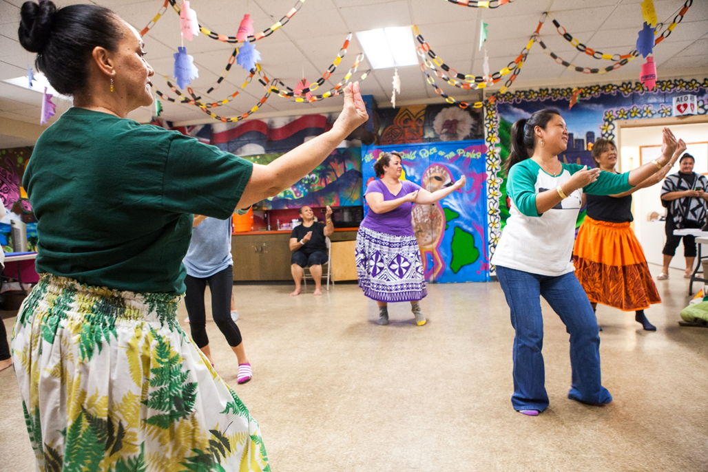
Screened for eligibility (N = 446)
Excluded (N = 183)
BP did not meet criteria (n=52)
Previous heart condition (n=40)
Not NH (n=43)
Schedule conflict (n=29)
No longer Interested (n=15)
Other (n=4)
Randomized
(N = 263)
Basic Heart Health Education
Education-only wait-list control
(N=132)
Ola Hou I ka Hula Program
(N=131)
3 month assessment
(N=115)
Eligibility
Native Hawaiian with physician-diagnosed hypertension
SBP ≥ 140 mmHg (with diabetes, ≥ 130 mmHg)
No heart disease or stroke
Under a physician’s care for ≥ 6 months
≥ 18 years of age
Independently ambulatory
3 month assessment
(N=126)
87% retention
91.6% retention
6 month assessment
(N=112)
6 month assessment
(N=105)
85% retention
87% retention
Intervention offered
12 month assessment
R01HL126577 (Kaholokula)

Slide 15
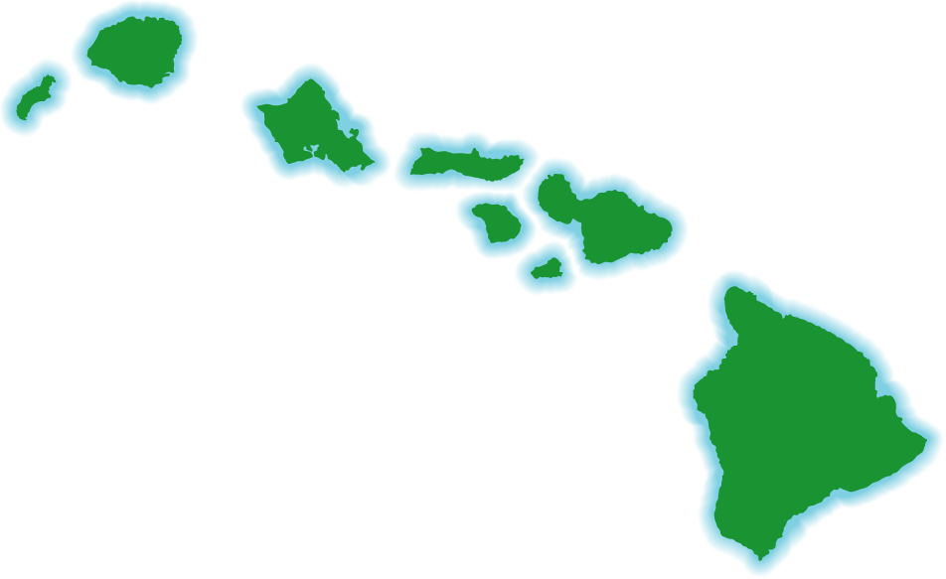





Recruitment, Implementation & Assessment Sites
Kauaʻi
Oʻahu
Niʻihau
Molokaʻi
Maui
Lānaʻi
Kahoʻolawe
Mauli Ola
Hawaiʻi
(Big Island)
R01HL126577 (Kaholokula)

Slide 16
Phase I: Hula Training
Two 60-min. Hula classes per week for 12-weeks
  ~15 participants per cohort
  Led by a kuku hula trained on standardized protocols.
Goal of each hula class was to Increase minutes of continuous dancing.
R01HL126577 (Kaholokula)
Notes:
VO₂ max refers to how much oxygen your body can absorb and use during exercise. It measures …
If you’re looking to improve your aerobic fitness, you might consider maximizing your VO₂ max (sometimes called your oxygen uptake).

Slide 17
Phase II: Maintenance Phase
Ma Ka Hana Ka ’Ike
Week | Activities
13 | Goal setting
14 | Worksheets: Values and time management
15 | Education review
16 | Hula training
17 | Peer discussion
18 | Education review
19 | Stress management education
20 | Hula training
21 | Peer discussion
22 | Education review
23 | Revisiting goals
24 | Hula training
This phase is based on Indigenist and self-regulation theories to help with sustained behavior change.
R01HL126577 (Kaholokula)

Slide 18
Baseline Characteristics
In total, we had…
  263 Native Hawaiians (131 immediately received Ola Hou)
  84% were female
  Average age was 58 years
  45% had diabetes
  86% were on medication for their high blood pressure
  73% had danced hula before
  Average starting blood pressure was 144/85 mmHg
  Balance in baseline characteristics, with the exception of weight.
R01HL126577 (Kaholokula)
Kaholokula, J.K et al. (2021). A Cultural dance program improves hypertension control and cardiovascular disease risk In Native Hawaiians: A randomized controlled trial. Annals of Behavioral Medicine, 55(10), 1006–1018.

Slide 19
Systolic Blood Pressure Outcomes
RR = 1.8 (1.4, 2.2), p <0.001
*
Note: The waitlist control group offered the intervention after 6-month data collection. 12-month data Is only intervention group.
R01HL126577 (Kaholokula)
Kaholokula, J.K et al. (2021). A Cultural dance program improves hypertension control and cardiovascular disease risk In Native Hawaiians: A randomized controlled trial. Annals of Behavioral Medicine, 55(10), 1006–1018.

Slide 20
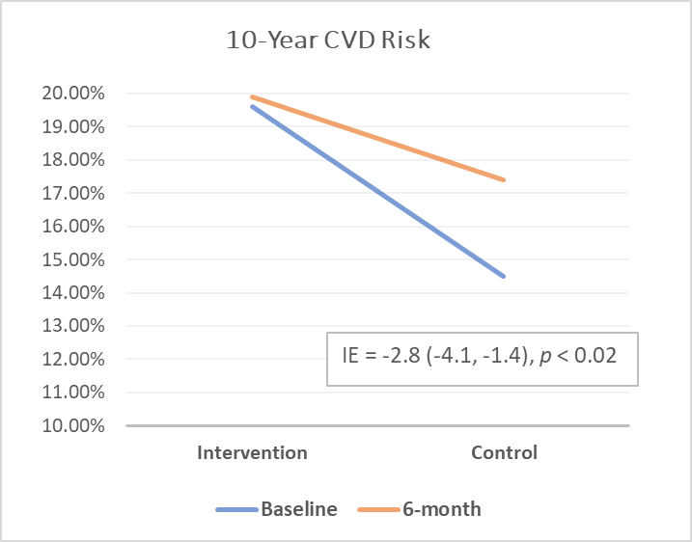
10-Year CVD Risk Outcome
Framingham Risk Scores – CVD
  Accounts for age, sex, systolic BP, HDL, total cholesterol, smoking and diabetes status, and pharmacologic treatment for HTN (yes vs. no).
Ola Hou participants had nearly double the risk reduction compared to education-only waitlist control participants
  5.2% versus 2.6% risk reduction (P = .02).
Control
Intervention
Baseline
6-month
R01HL126577 (Kaholokula)
Kaholokula, J.K et al. (2021). A Cultural dance program improves hypertension control and cardiovascular disease risk In Native Hawaiians: A randomized controlled trial. Annals of Behavioral Medicine, 55(10), 1006–1018.

Slide 21
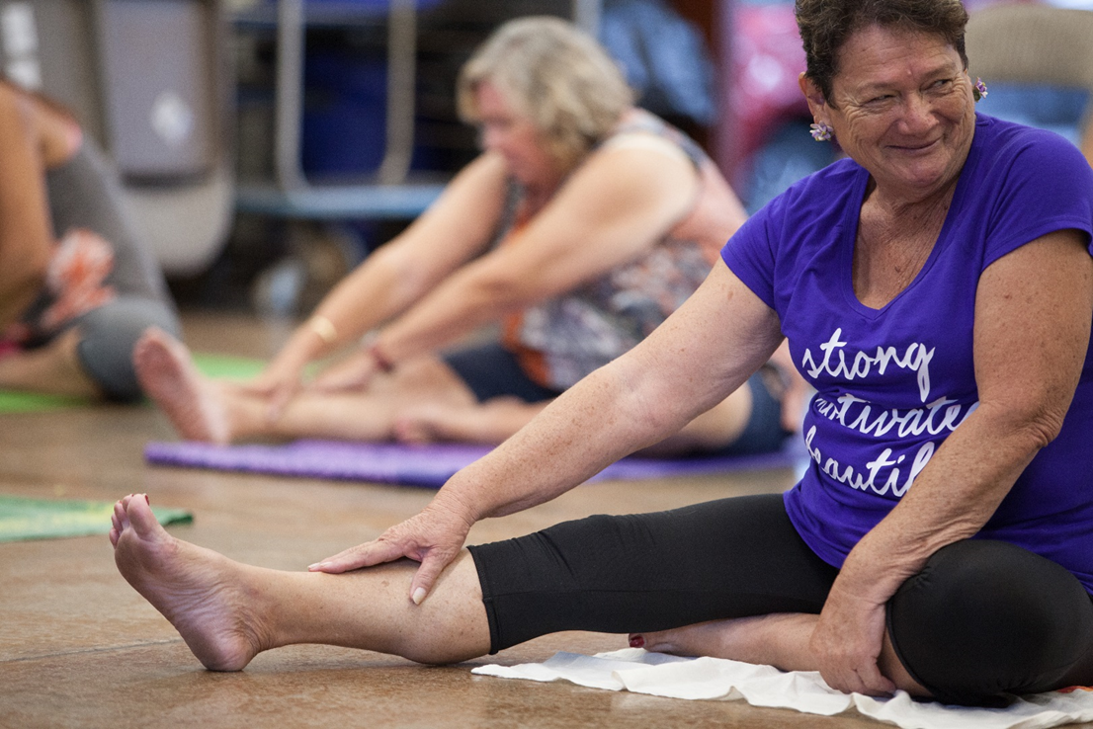
Conclusion
Overall findings
Ola Hou improved blood pressure control and CVD risk.
Improvements held 12 months out.
Effectively implemented across different community and clinical settings.
Outstanding recruitment and retention.
Other findings and lessons learned
Increased social and cultural connectedness.
Decreased perceptions of racism.
Improved medication adherence
Validated hula as a healing practice.
Increased community capacity to engage in health promotion.
Other contributions to science and the community
Shifted the paradigm of health promotion.
Ola Hou is offered in primary care and other community-based settings.
Reimbursement for hula by a local medical insurer (AlohaCare).
Inspired other Indigenous communities.
Applying Ola Hou to other health concerns.
Future directions
Establish the hula program efficacy for other health issues:
  Preventing Alzheimer’s disease
  Fall prevention
Dissemination and implementation project.
Third-party reimbursement.
Notes:
83% at 6-months; 77% at 12-months.

Slide 22

Mahalo Nui
KāHOLO Project funded by the National Heart, Lung, and Blood Institute (R01 HL126577).
‘Ike Kupuna Project funded by the National Institute of Aging (P01AG066584)
  The content of this presentation Is solely the responsibility of the presenter(s) and does not necessarily represent the official views of the National Institutes of Health.

