Slide 1
How American Indian Trauma Focused Practice can Inform Native Hawaiian and Indigenous Care
Trauma Focused Care through a Cultural Safety Lens
Cynthia Taylor Greywolf, PhD, DNP-PMHNP, BC
Cherokee Nation Citizen (Federal Tribal ID)
Assistant Professor and Psychiatric Nurse Practitioner
School of Nursing
The University of Hawaii at Manoa

Slide 2
Who I am
Because I am speaking about:
  Trauma Informed Care
  through the lens of Cultural Safety,
  It becomes important to tell you who I am.

Slide 3


Identities
  Deer Clan
  Storyteller
  Daughter
  Granddaughter
  Mother
  Grandmother
  Sister
  Aunt
  Nurse Practitioner/Educator/Researcher
`

Slide 4
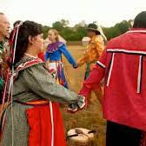
Cherokee Lived Experience
Dispossession of Land
Forced Removal (Trail of Tears)
Boarding School (Dwight Mission)
Poverty
Discrimination
Problem Alcohol Use

Slide 5
Impact of Colonization
Illegal to speak our language, practice religious traditions until 1978.
American Indian Religious Freedom Act signed by President Carter.
We practiced traditions in hiding.

Slide 6
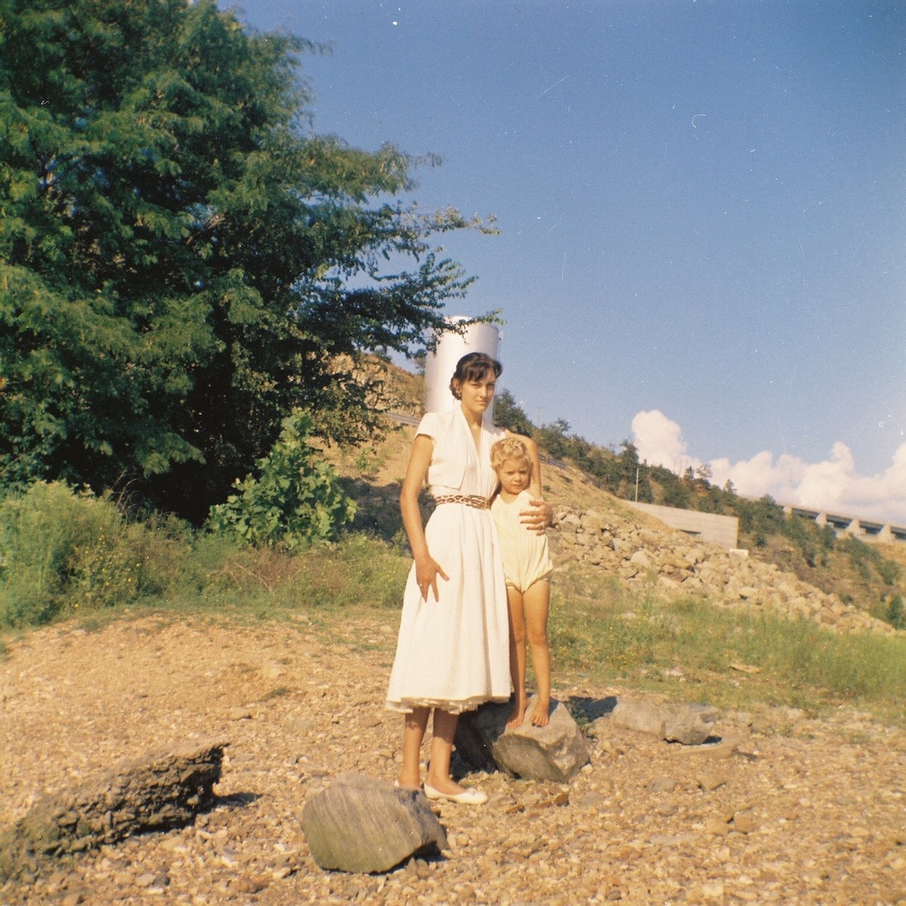
Assimilation

Slide 7
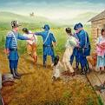

Indian Removal Act, 1830
  16,000 Cherokee held in stockades.
  Inadequate food, clothing, no shelter.
Approx 4000 to 8000
Cherokee died waiting in
the stockades.

Slide 8
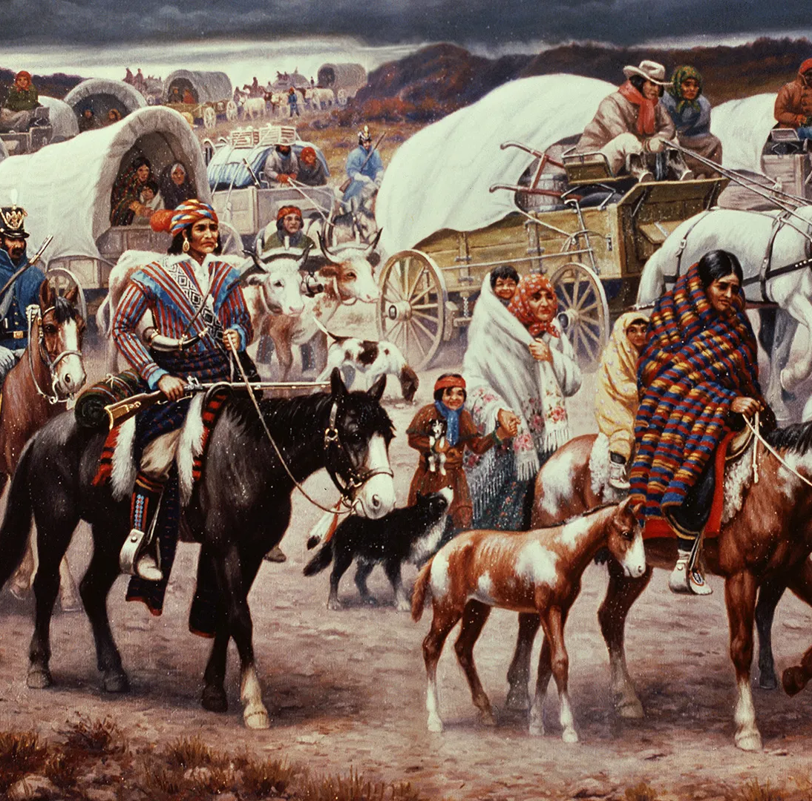
Trail of Tears (1839)
  US forcibly marched roughly 8000 to “Indian territory” (Present day Oklahoma).
  Forced to start walking from Georgia to Oklahoma at gunpoint.
  1200 miles. In middle of Winter. No blankets, no food, no shelter.

Slide 9
Personal Impact
  My ancestor was among the survivors forced to march the 1200 miles from Georgia to Oklahoma.
  Only 1 survived.
    Lizzie Og’ana, my great, great grandmother.
  She was 13.

Slide 10
American Indian Historical Context
1.5 Billion Acres appropriated from Indigenous people by U.S Gov (1776-Present).
1492, Columbus arrival - estimated 60 million +Natives.
1893, approximately 250,000 left – goal to exterminate by death or assimilation.
Today we are invisible and ignored.

Slide 11
Native Hawaiian Historical Context
Captain Cook arrived in the Hawaiian Islands. In 1778
286 years after Columbus had arrived on Turtle Island
After contact decline in Native Hawaiians people- a loss of 95%.
Alcohol was introduced by Westerners

Slide 12


My Purpose
(Informed by my lived experiences)
To give Voice to Indigenous peoples’ mental health and substance use disparities through the lens of historical trauma using trauma informed care.

Slide 13
Why it Matters
Live shorter, more challenging lives.
Highest prevalence of physical & psychiatric illness, alcohol/drug use.
Compounded by racism, discrimination, oppression, marginalization.
Native people do not trust non-Native providers Almost impossible for non-natives to conduct this research.

Slide 14
Cultural Safety
Cultural awareness
Cultural sensitivity
Cultural Safety allows those receiving care to define it.
Cultural safety focuses on power imbalances
Acknowledges power differences between Providers and patients

Slide 15
Cultural Safety aligns with Trauma Informed Care for Indigenous populations.

Slide 16
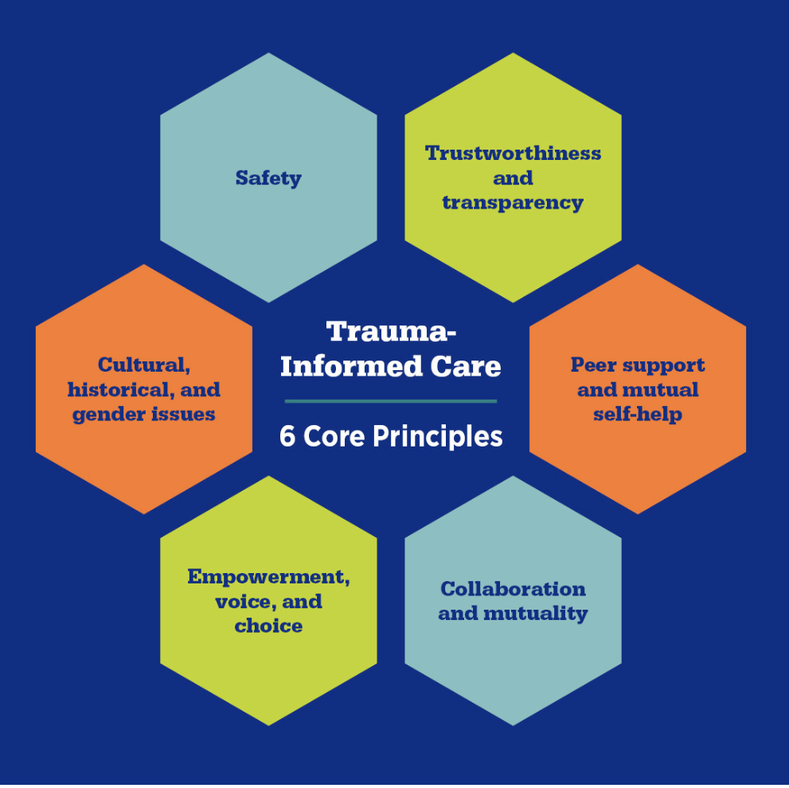
Trauma Informed Care

Slide 17

Safety
Ensure physical and emotional safety.

Slide 18
Choice
The individual has choice and control.
Provided a clear and appropriate message about their rights and responsibilities.

Slide 19

Collaboration
Making decisions with the Individual and sharing power.
Provided with a role in the planning and evaluation of treatment plan.

Slide 20
Trustworthiness
Task clarity
Consistency
Interpersonal boundaries

Slide 21
Empowerment
Providing an environment where the individual feels validated and affirmed.
Building
Skill building
Prioritizing
Prioritizing empowerment

Slide 22

Cultural, Historical and Gender Issues

Slide 23
Case Study (Jessie)
Jessie is a 44-year-old two-spirit Dine′ man who was court mandated to present at the community health center for a psychiatric evaluation.
Jessie had been jailed for the twenty-third time

Slide 24
Jessie’s incarcerations had involved:
  Meth possession
  violent assaults,
  alcohol intoxication
  destruction of private and
  public property, DUIs

Slide 25
Multiple Psychiatric Diagnosis
Bipolar II disorder, schizoaffective disorder, schizophrenia, PTSD, intermittent explosive disorder, depression, and anxiety, substance use disorder.
In addition to his psychiatric diagnoses. He had a recent suicide attempt with the Navajo police.

Slide 26
Medical Co-Morbidities
Jessie’s medical history included:
  morbid obesity –he weighed 420 pounds
  type II diabetes,
  hypertension,
  CHF,
  hyperlipidemia,
  kidney disease,
  gout,
  and GERD.

Slide 27
Impact of Psychiatric Neuroleptic Medications
Jessie had gained 200 pounds over two years
  on high doses of Zyprexa and Seroquel, two neuroleptic medications.
  These meds worsened his physical health.

Slide 28
Suspicion that many of the psychiatric diagnoses were inaccurate.
The use of alcohol and methamphetamine impaired and complicated Jessie’s life.
He was one of my most complicated patients.

Slide 29
Jessie experienced many adverse childhood events and traumatic events throughout his life
He has been subjected to discrimination and structural racism which has affected his mental and physical health.
The psychiatric diagnoses contributed to a social stigma and impacted Jessie’s chronic medical issues.
This provided a greater context for prioritizing Jessies issues

Slide 30
Outcome
Jessie was diagnosed with a complex form of post-traumatic stress disorder (PTSD).
All psychiatric medications were weaned with the exception of Prozac.
He lost over 200 pounds after being weaned off of neuroleptic medications.

Slide 31
Trauma Informed Care
Jessie was treated using the guiding principles of
  Trauma Informed Care
  and Cultural Safety

Slide 32
Wado (Thank you)!

Slide 33
Questions?

